Slide 1
CIS 565 CUDA Performance Lab Profiling
Shehzan Mohammed
@shehzanm

Slide 2
Nsight Legacy vs Next-Gen
Nsight is undergoing a complete rewrite
2 versions now exist – Legacy and Next-Gen
https://docs.nvidia.com/nsight-visual-studio-edition/Nsight_Visual_Studio_Edition_User_Guide.htm#System_Requirements.htm
See “Compute Debugger Supported Configurations”

Slide 3
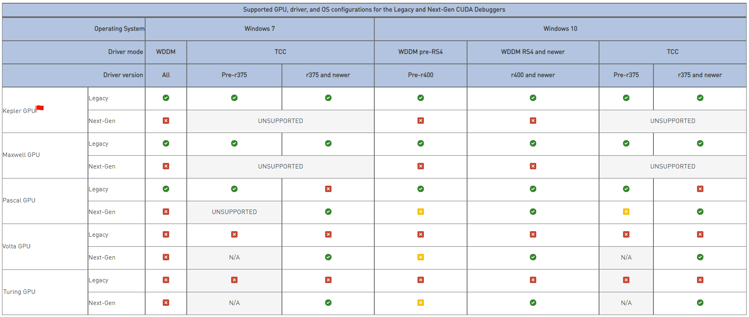
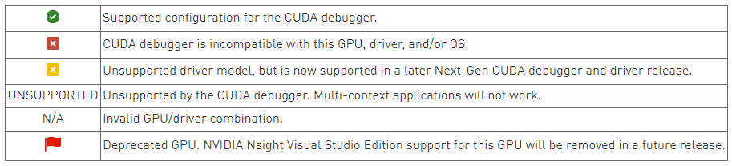
Support GPU, Driver and OS Configuration for Legacy and Next-Gen CUDA Debuggers
Notes:
WDDM: Windows Display Driver Model (This is the regular mode when a display is connected to a GPU)
TCC: Tesla Compute Cluster (This is for non-display GPUs, like Tesla series, and for other GPUs whose mode can be set to TCC when not connected to a display)
r400: NVIDIA Driver 4xx.yy
Check using nvidia-smi command

Slide 4
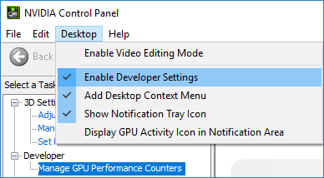
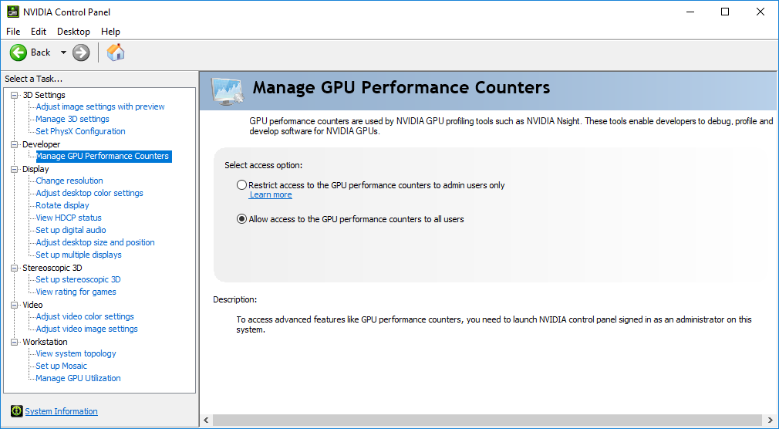
Update NVIDIA Settings
NVIDIA requires new permissions for profiling
Problem: https://developer.nvidia.com/nvidia-development-tools-solutions-err-nvgpuctrperm-NsightCompute
Fix: https://developer.nvidia.com/nvidia-development-tools-solutions-ERR_NVGPUCTRPERM-permission-issue-performance-counters
Alternate is to always run using Admin, which is not great

Slide 5
Legacy Tools Nsight and NVVP
Pascal

Slide 6
Legacy Profiling Tools
Nsight Profiler
NVIDIA Visual Profiler(NVVP)
NVVP and nvprof have been deprecated as of CUDA 10

Slide 7
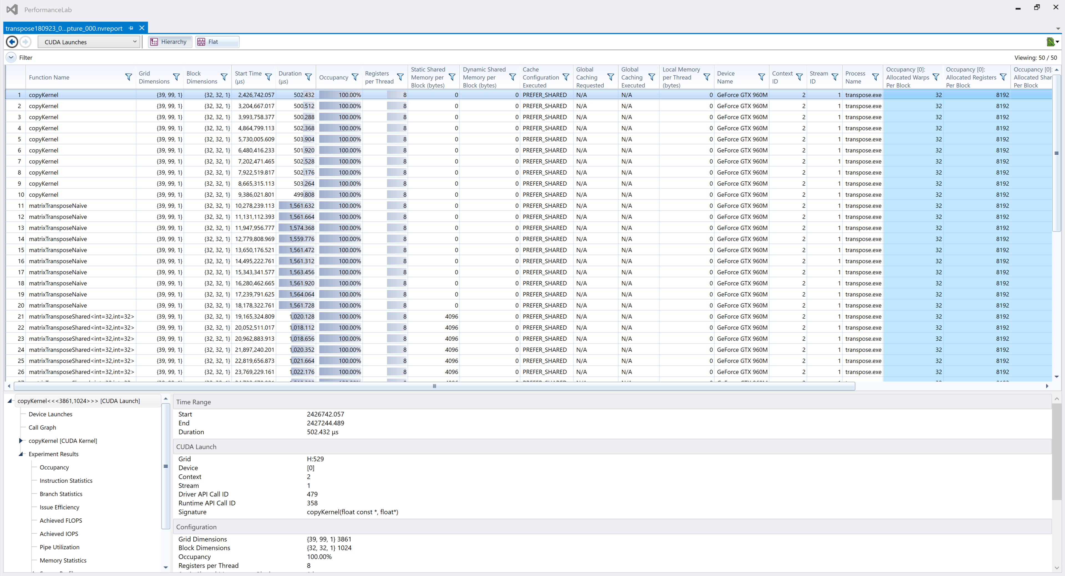
Nsight Profiler
https://docs.nvidia.com/nsight-visual-studio-edition/Nsight_Visual_Studio_Edition_User_Guide.htm#Analysis_Tools_Overview.htm%3FTocPath%3DAnalysis%2520Tools%7C_____0

Slide 8
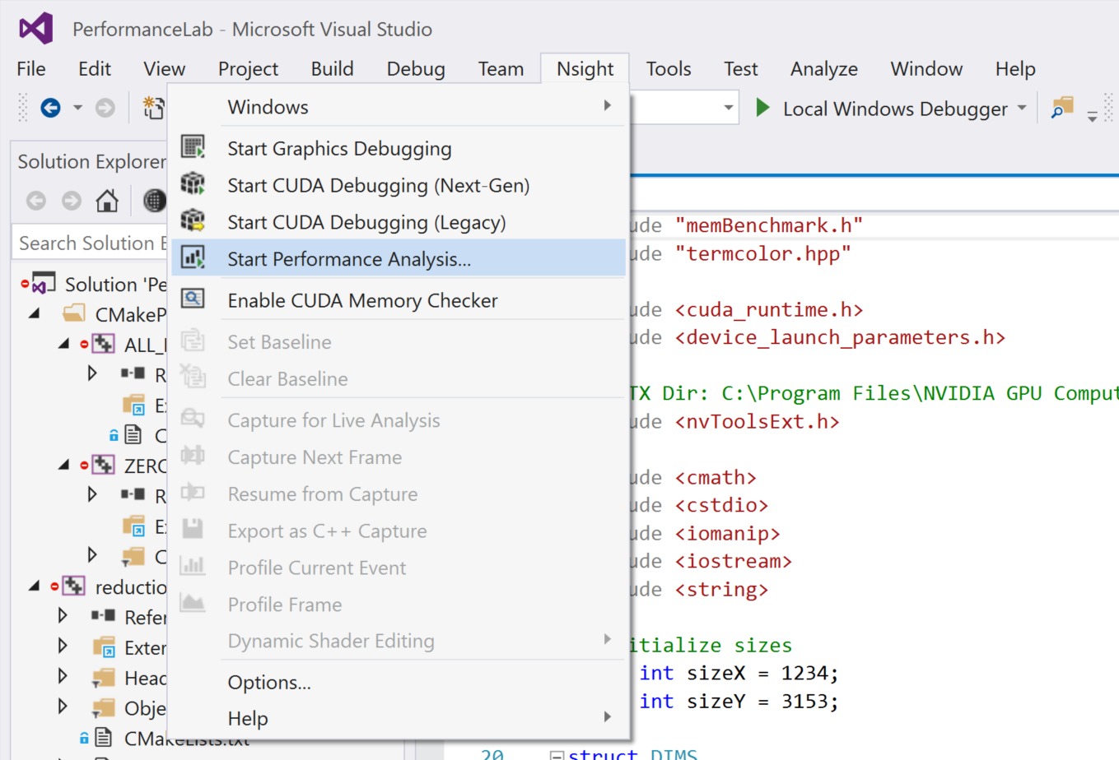
Running Nsight Profiler
Nsight -> Start Performance Analysis

Slide 9
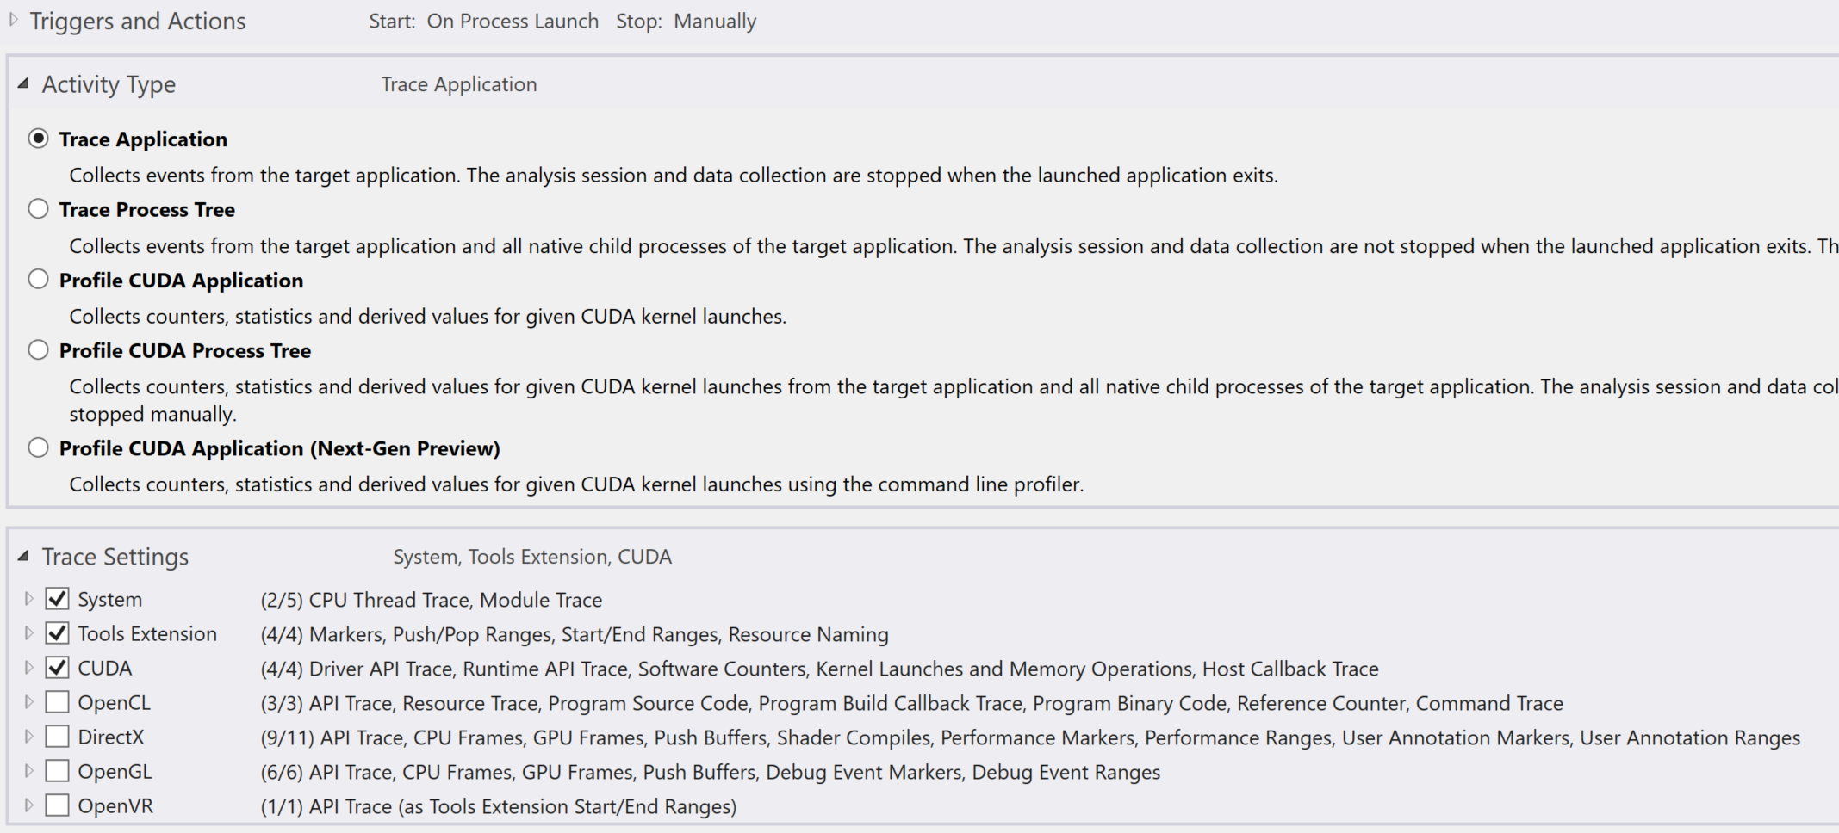
Let’s start with Trace Application
Select System, Tools Extension, CUDA in Trace Settings
https://docs.nvidia.com/nsight-visual-studio-edition/5.6/Nsight_Visual_Studio_Edition_User_Guide.htm#Analysis_Trace_Settings.htm%3FTocPath%3DAnalysis%2520Tools%7C_____3
Notes:
System: CPU functions etc
Tools Extensions: Ranges, Names, events etc (used for performance timings)
CUDA: Driver, Runtime, Memory, Kernels etc

Slide 10
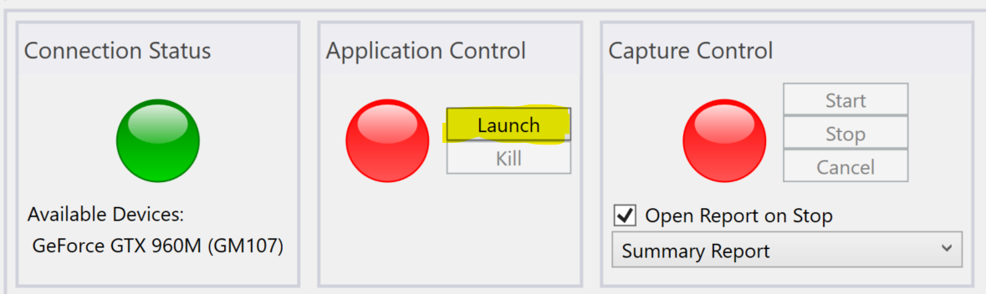
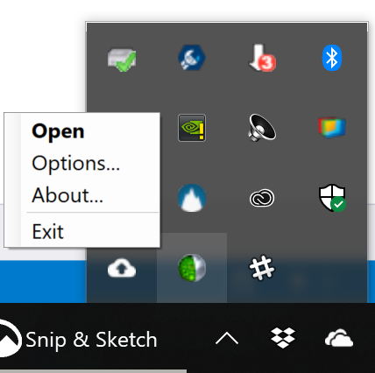
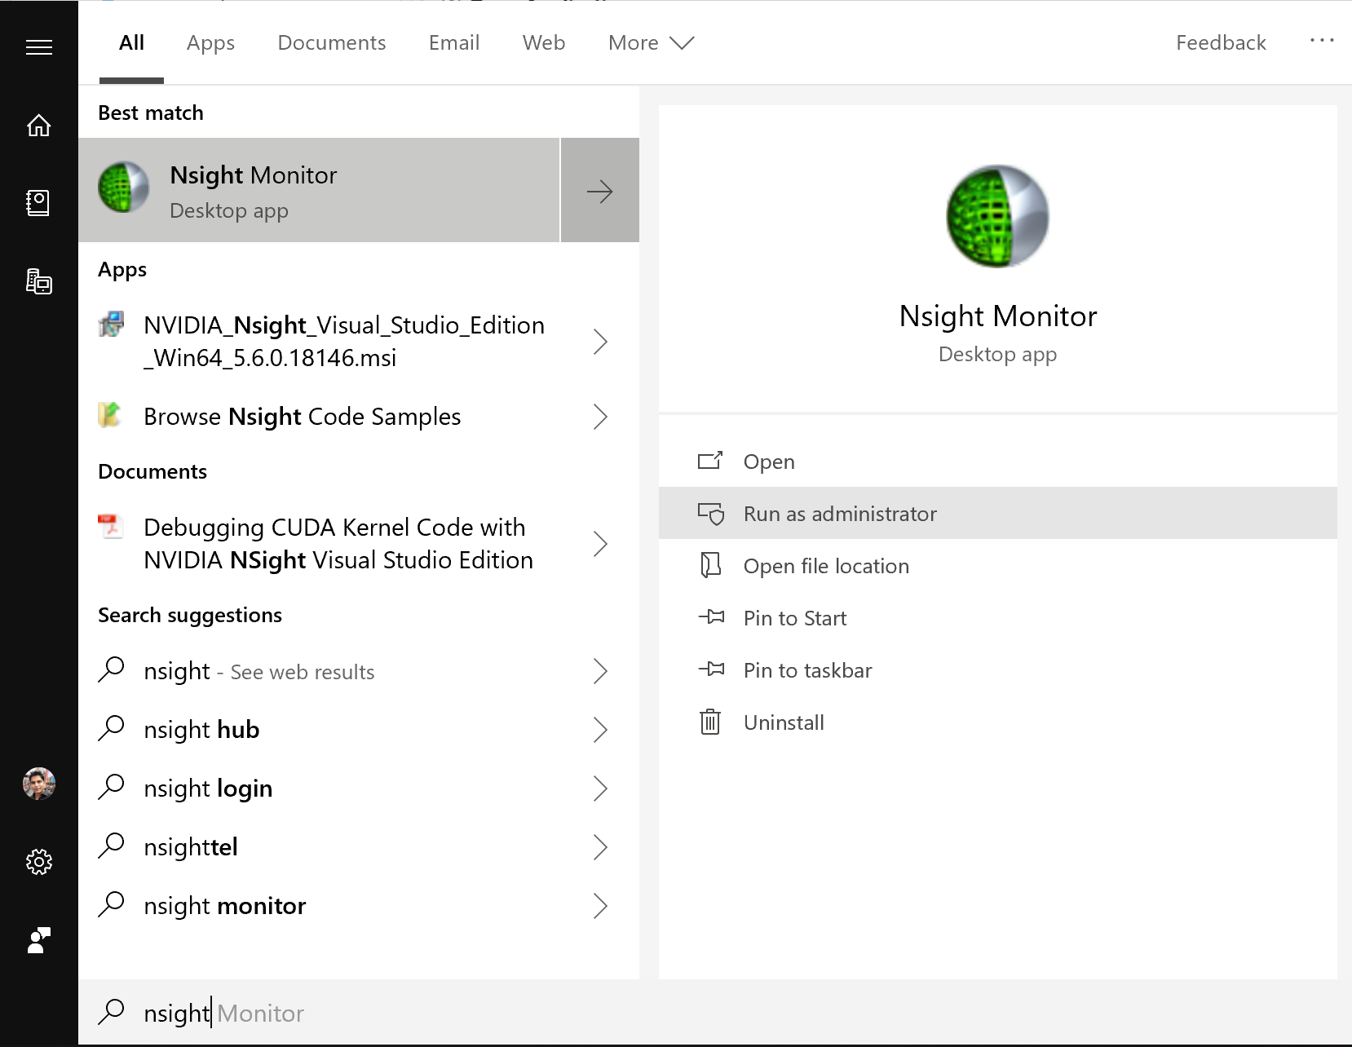
Let’s start with Trace Application
Click Launch
If you get “Trace with System requires elevated permissions…”
Exit Nsight Monitor from notification icon.
Then launch as administrator

Slide 11
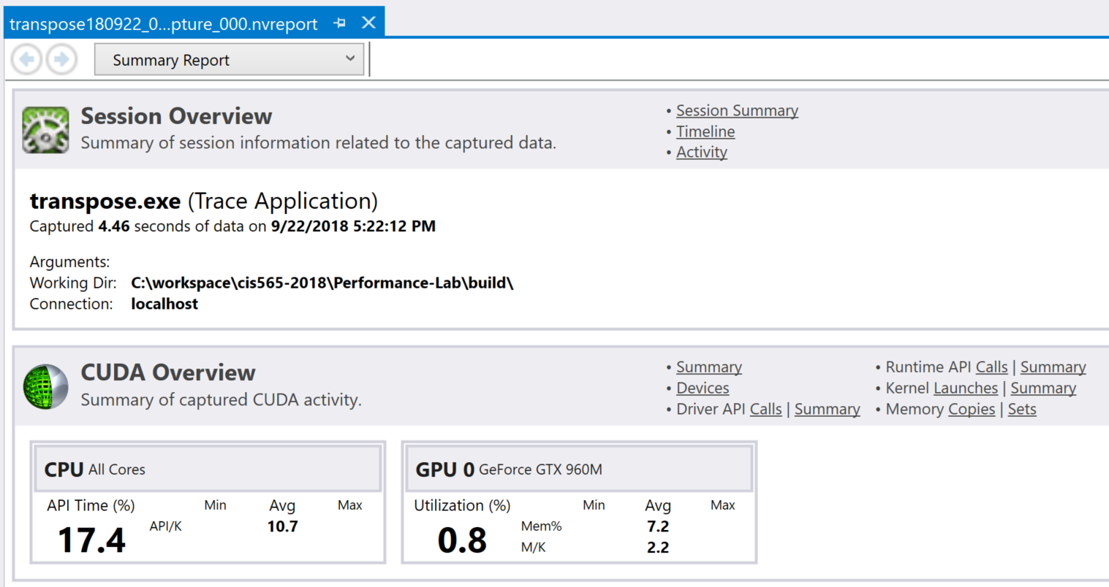
Produces a report
Notes:
https://docs.nvidia.com/nsight-visual-studio-edition/5.6/Nsight_Visual_Studio_Edition_User_Guide.htm#Analysis_Reports.htm%3FTocPath%3DAnalysis%2520Tools%7C_____2

Slide 12
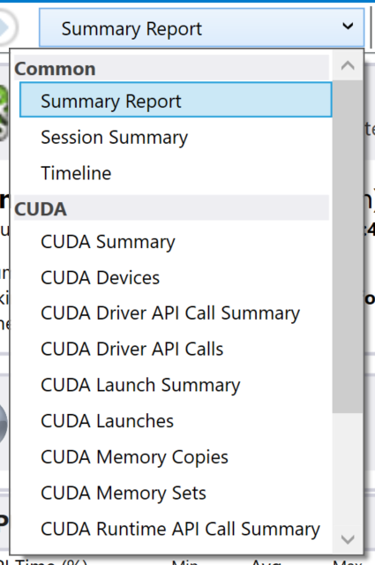
Produces a report
Notes:
https://docs.nvidia.com/nsight-visual-studio-edition/5.6/Nsight_Visual_Studio_Edition_User_Guide.htm#Analysis_Reports.htm%3FTocPath%3DAnalysis%2520Tools%7C_____2

Slide 13
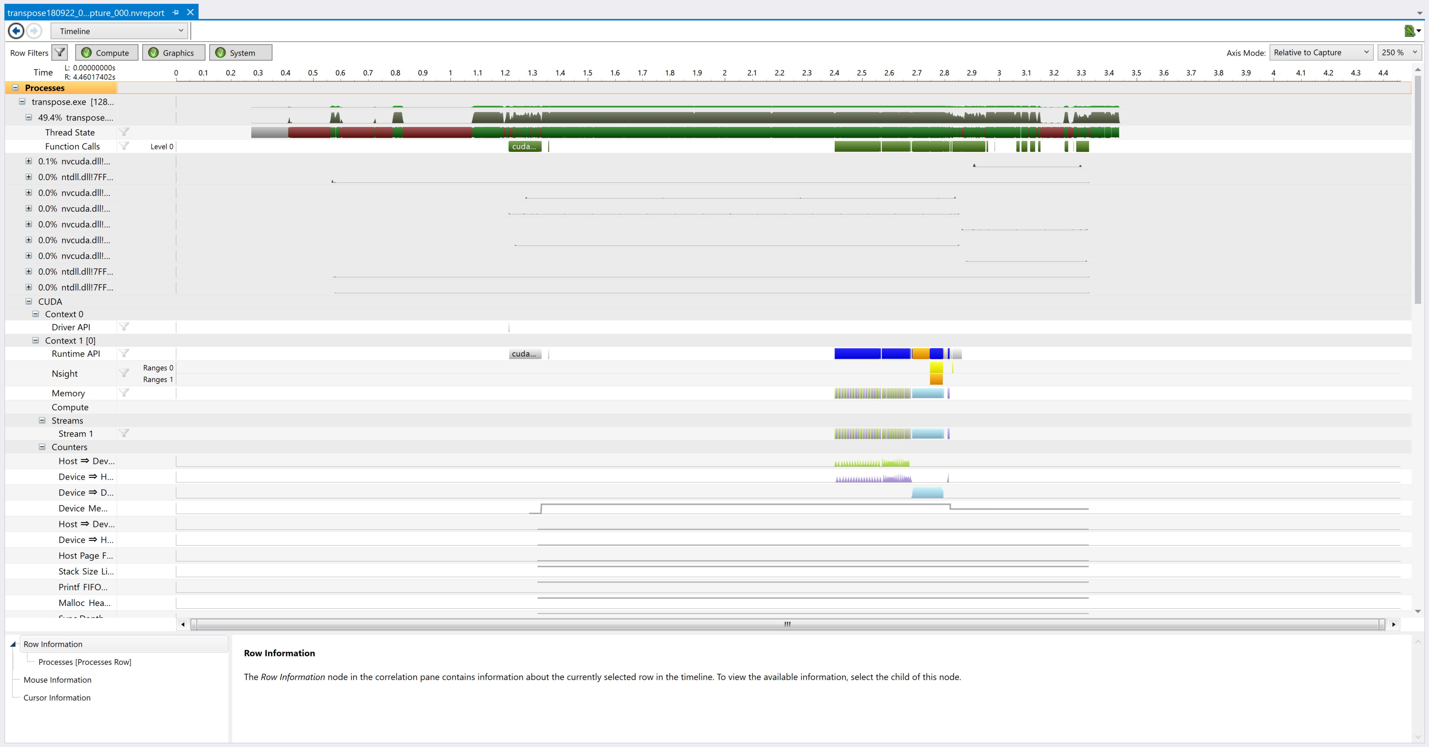
Timeline
https://docs.nvidia.com/nsight-visual-studio-edition/5.6/Nsight_Visual_Studio_Edition_User_Guide.htm#Timeline_Report.htm%3FTocPath%3DAnalysis%2520Tools%7COther%2520Analysis%2520Reports%7CTimeline%2520Page%7C_____0
Notes:
https://docs.nvidia.com/nsight-visual-studio-edition/5.6/Nsight_Visual_Studio_Edition_User_Guide.htm#Timeline_Report.htm%3FTocPath%3DAnalysis%2520Tools%7COther%2520Analysis%2520Reports%7CTimeline%2520Page%7C_____0

Slide 14
In Timeline, you can:
Click on individual function, API and kernel calls and find:
Start and end time in microseconds
See memory allocations, copies, types, direction, time, speed, size etc
See synchronization points – forced by user, forced by API etc
See kernel launches, execution, asynchronous behavior
Launch configuration and other API properties/arguments
See memory allocations over time
Double click to expand any row
*This is only a partial list
Notes:
CUDA memory allocations
Tools Extension -> Ranges
Paged/Pinned Memory transfer with size, speed, direction
Device to Device memory transfer with size, speed
Device to Host memory transfer with size, speed
Device memory allocated line graph (under Context 2 -> Counters)
CUDA memset before copy kernel
Copy kernel launches are different from CUDA kernel execution (asynchronous)

Slide 15
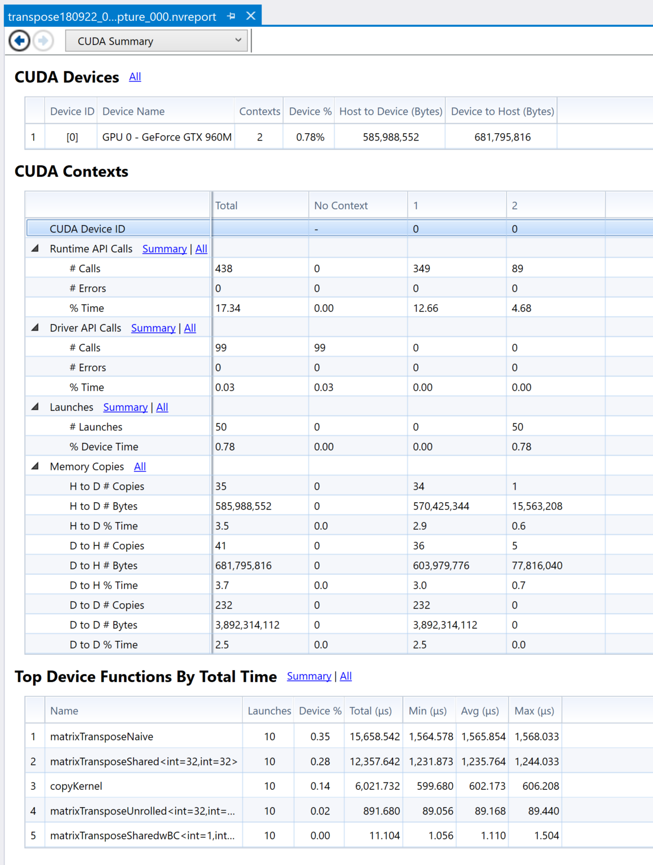
CUDA Summary

Slide 16
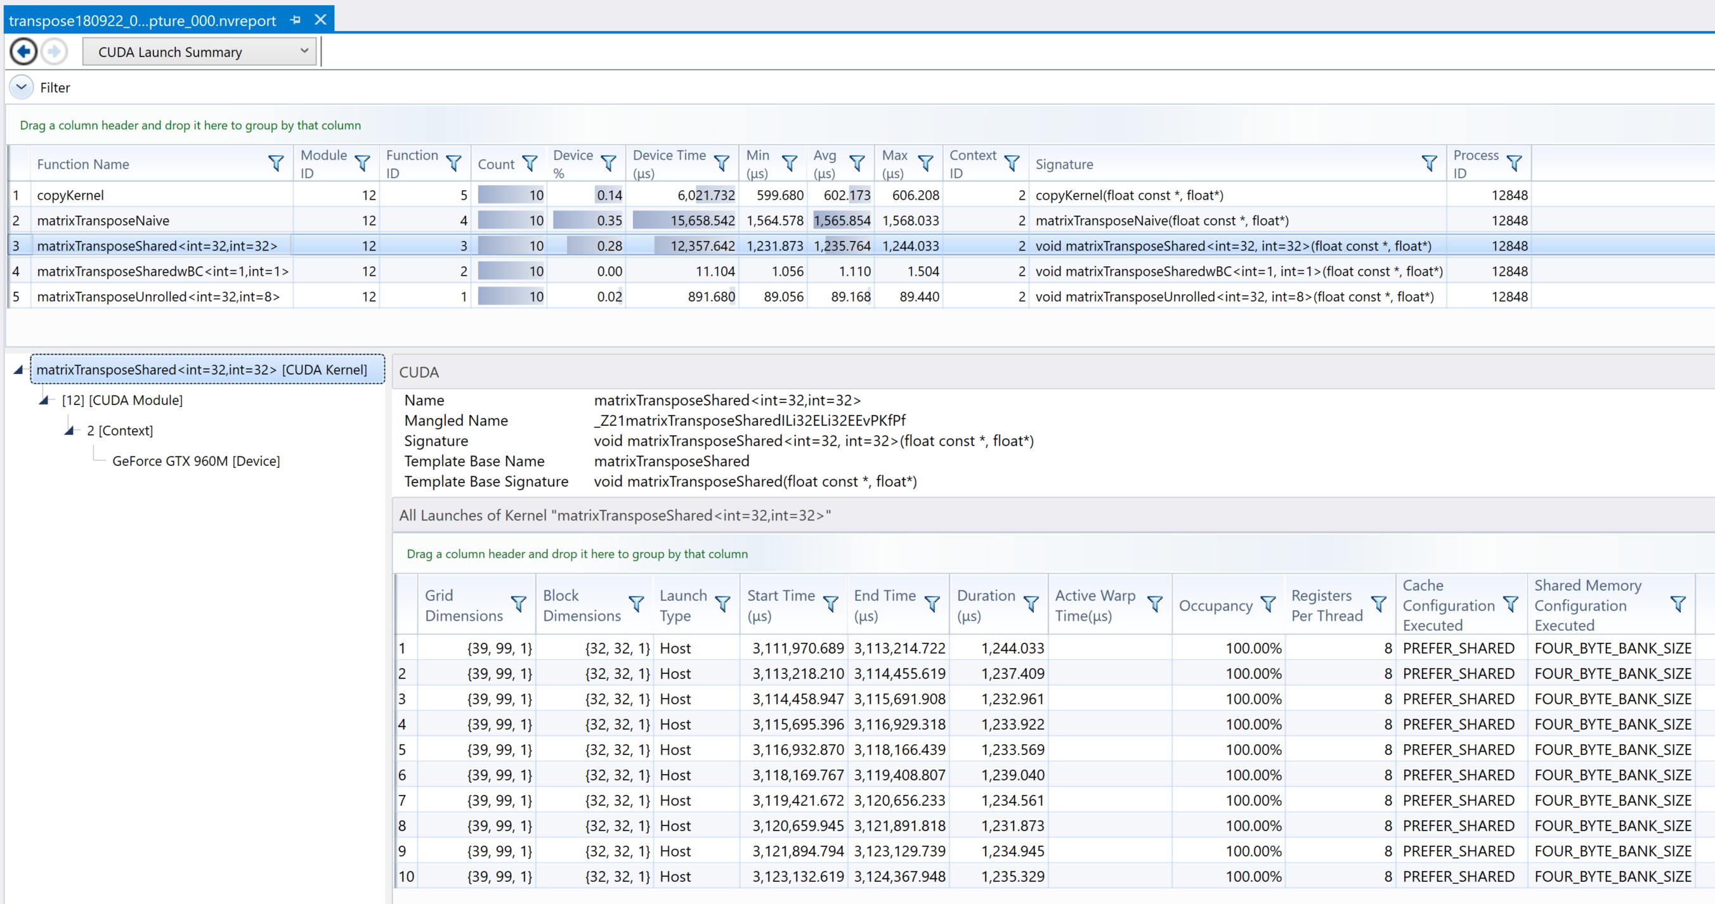
CUDA Launch Summary (Kernels - Grouped)

Slide 17
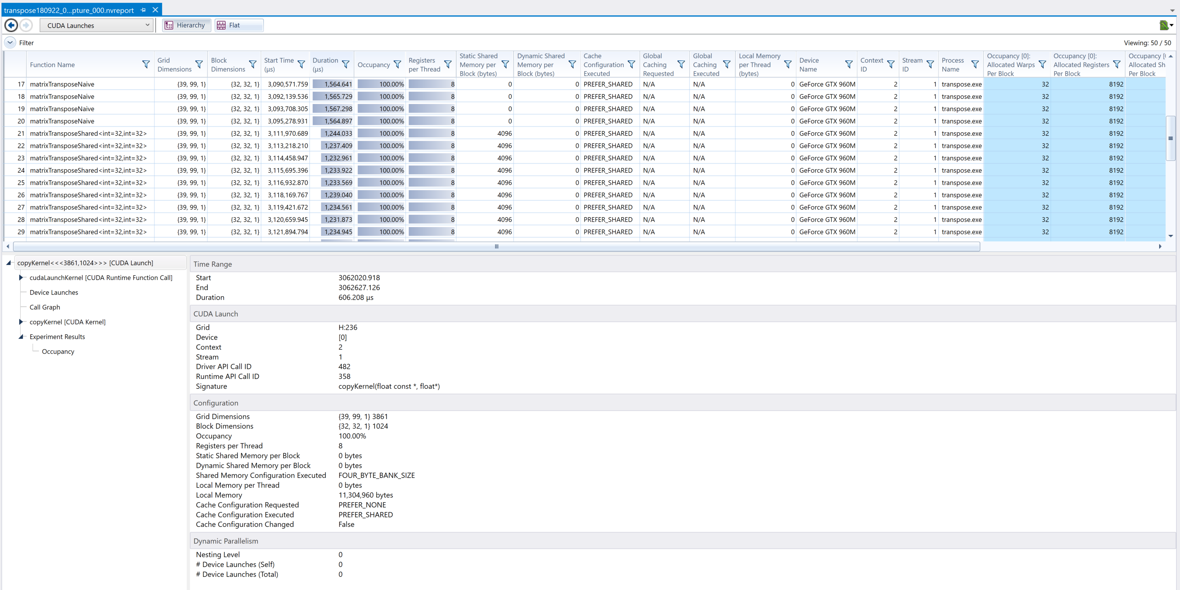
CUDA Launches (Kernels – by invocation)
Notes:
Show Experiment Results -> Occupancy

Slide 18
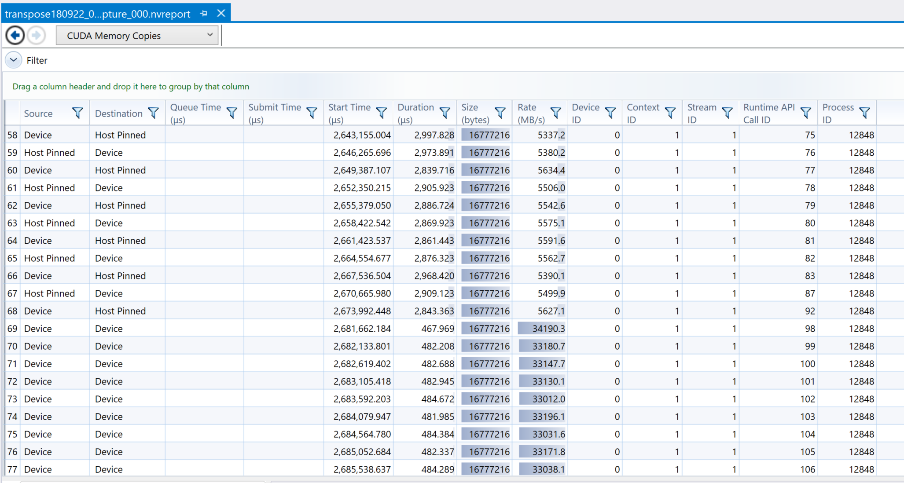
CUDA Memory Copies

Slide 19
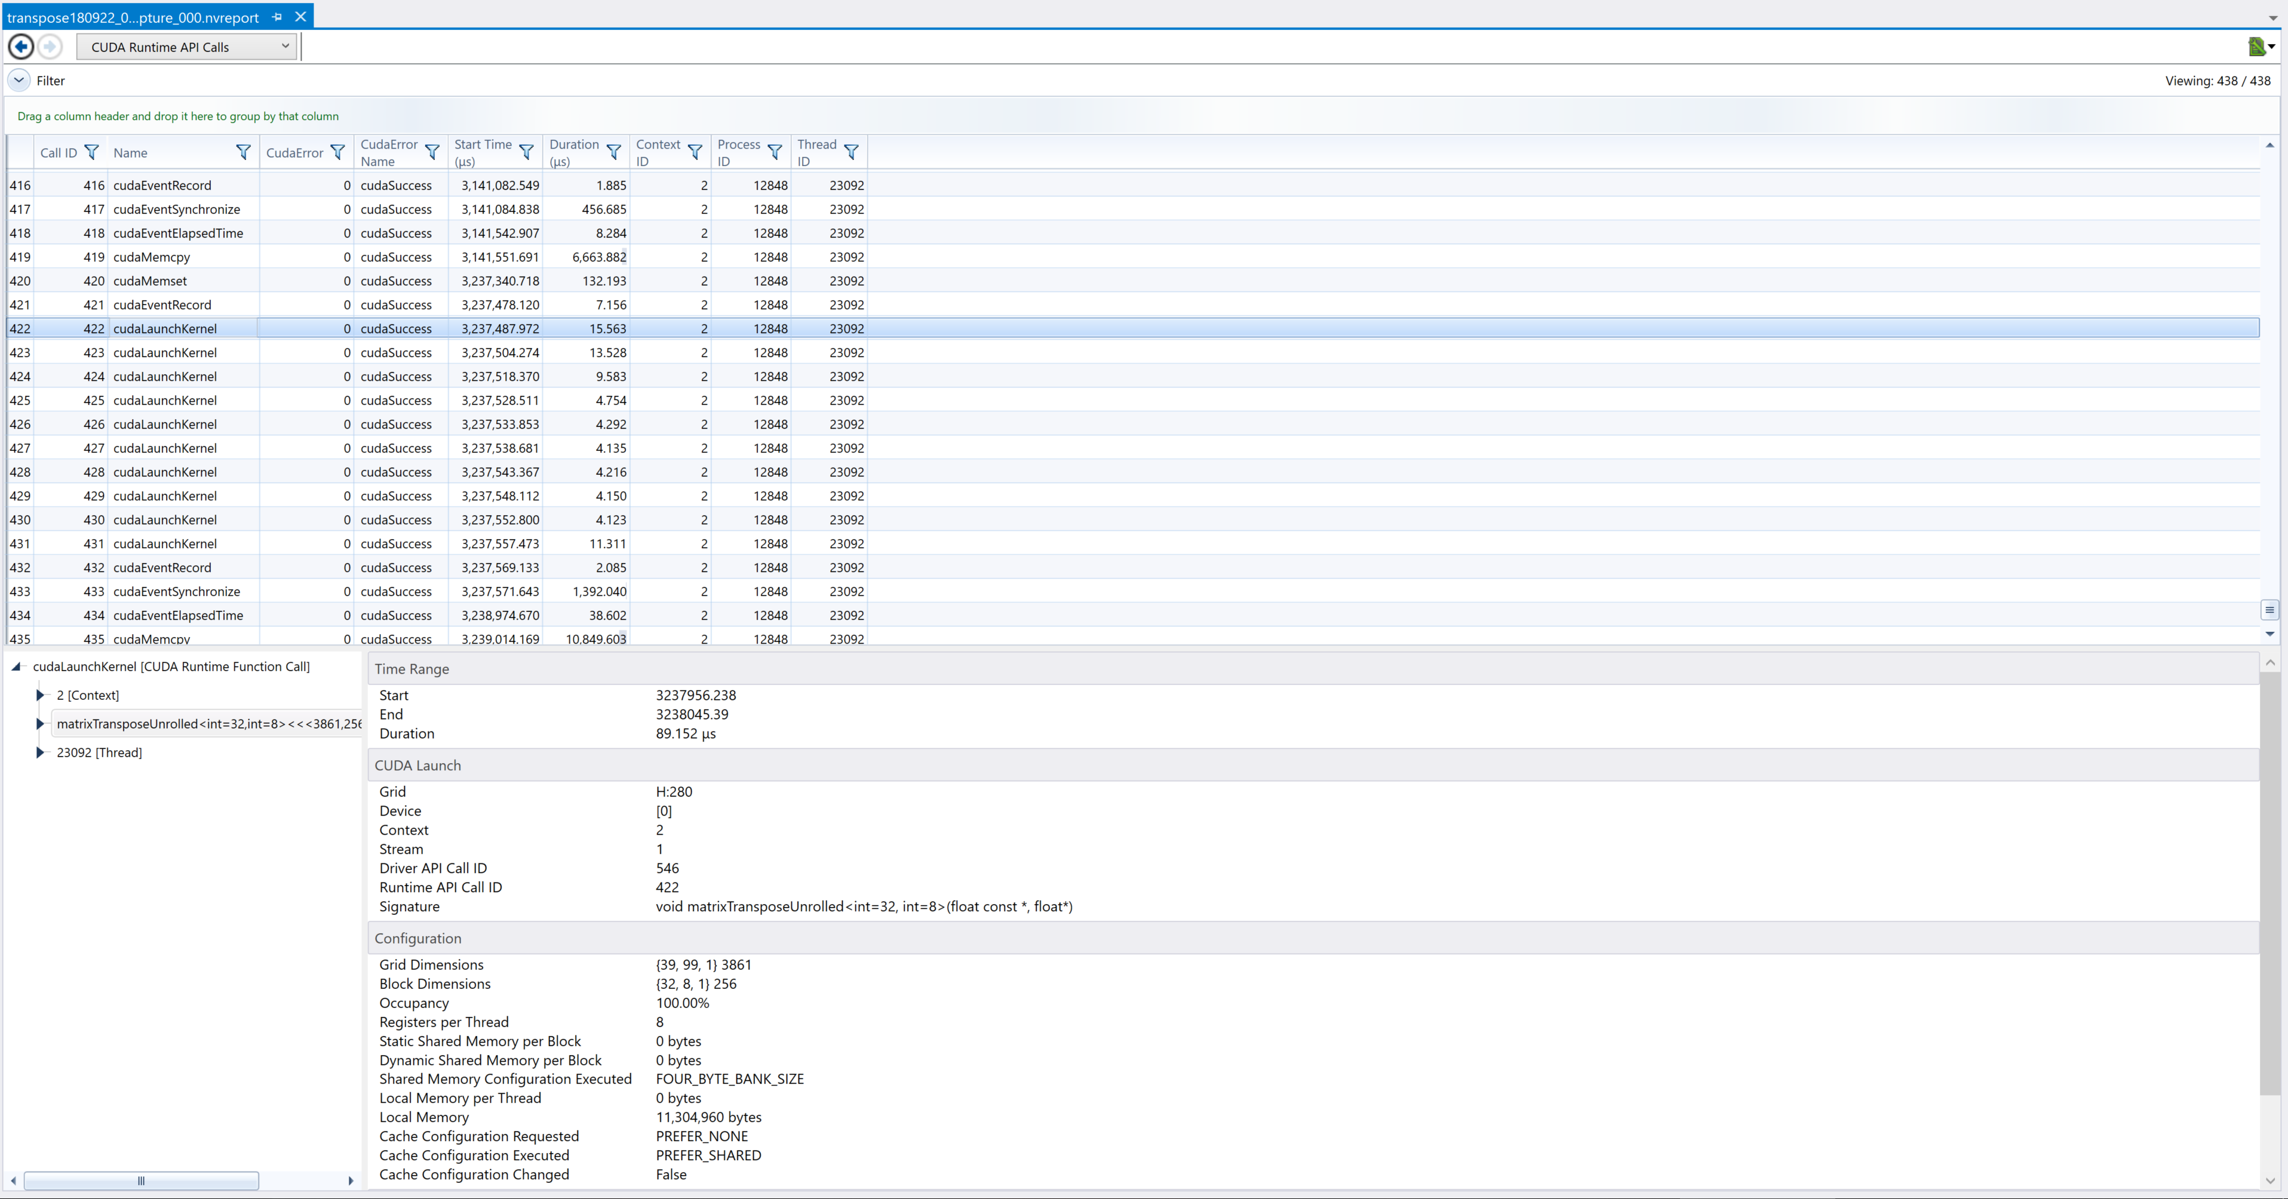
CUDA Runtime API Calls

Slide 20
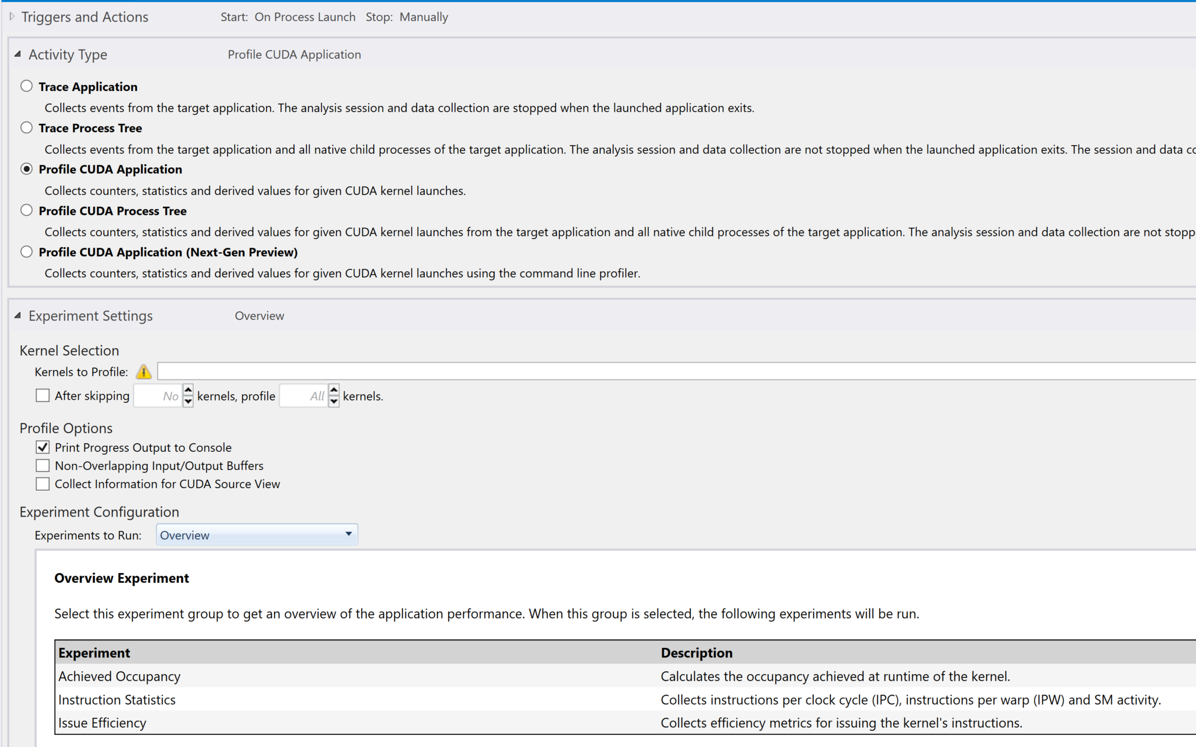
Let’s Profile CUDA Application
We’ll start with “Overview” Experiment
Notes:
https://docs.nvidia.com/nsight-visual-studio-edition/5.6/Nsight_Visual_Studio_Edition_User_Guide.htm#Profile_CUDA_Settings.htm%3FTocPath%3DAnalysis%2520Tools%7CCUDA%2520Experiments%7C_____0

Slide 21
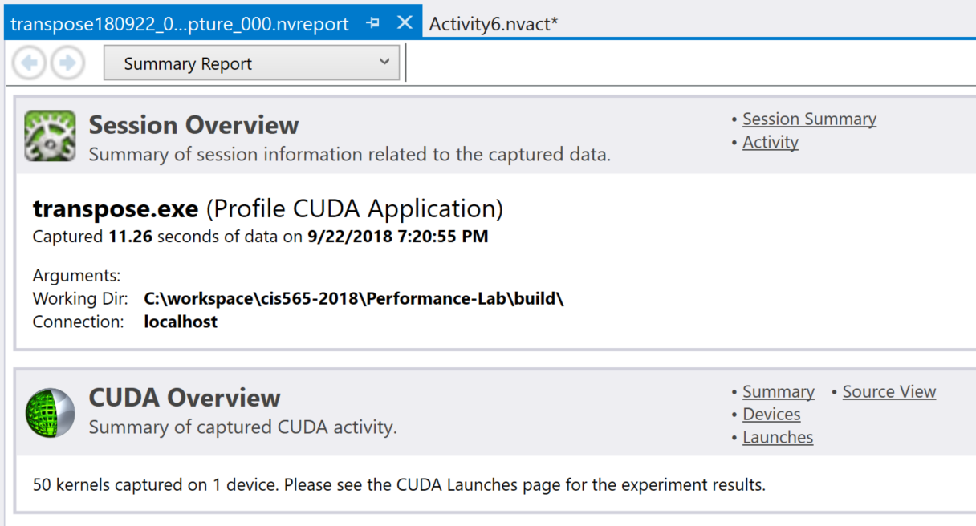
Produces a report

Slide 22
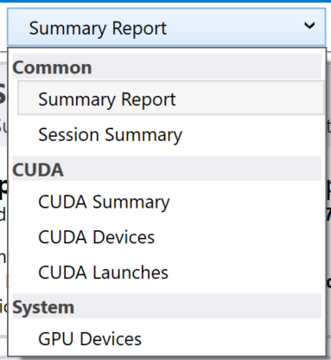
Produces a report

Slide 23
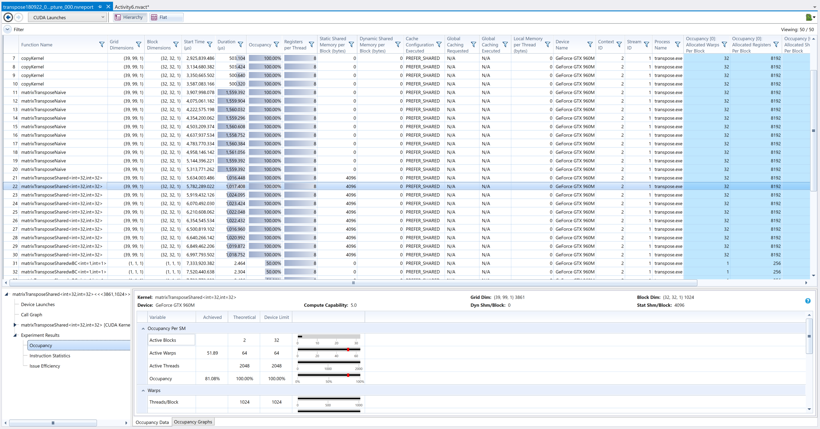
CUDA Launches

Slide 24
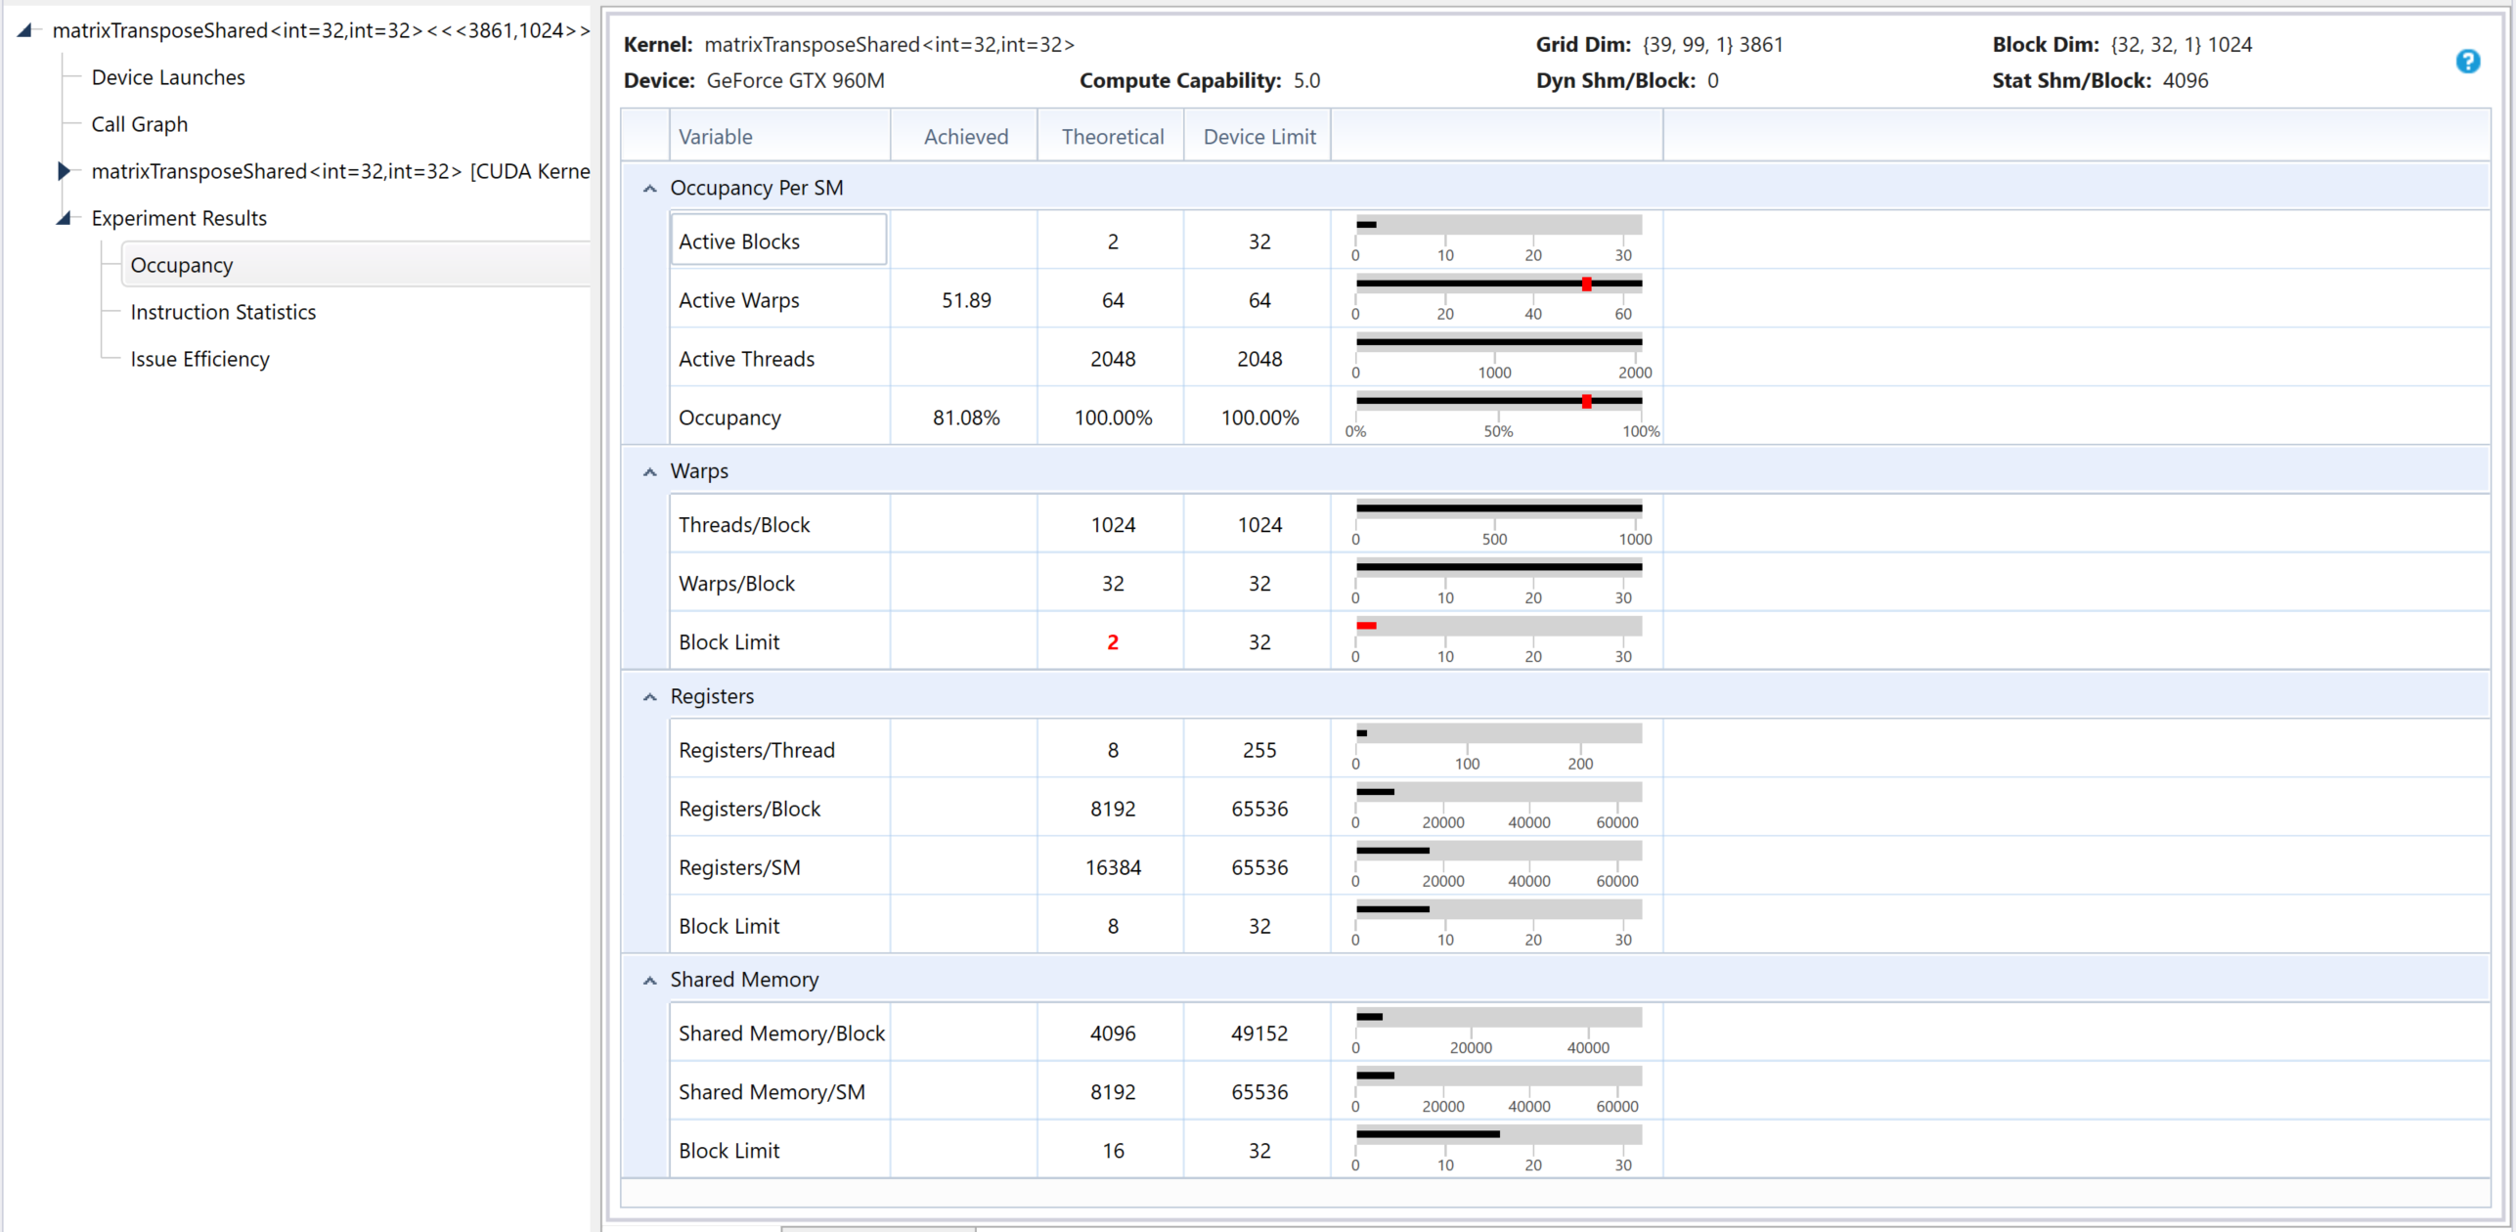
CUDA Launches – Occupancy Data
Notes:
https://docs.nvidia.com/nsight-visual-studio-edition/5.6/Nsight_Visual_Studio_Edition_User_Guide.htm#Analysis/Report/CudaExperiments/KernelLevel/AchievedOccupancy.htm%3FTocPath%3DAnalysis%2520Tools%7CCUDA%2520Experiments%7CKernel-Level%2520Experiments%7C_____1

Slide 25
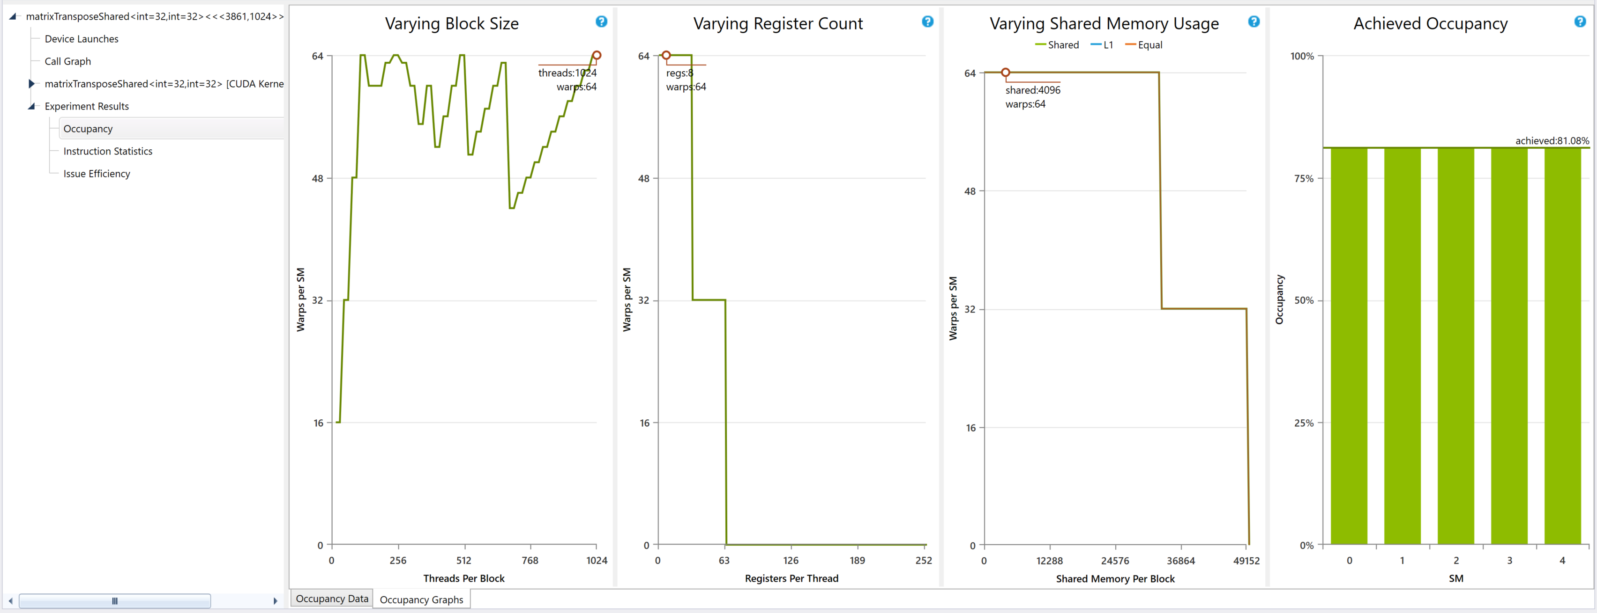
CUDA Launches – Occupancy Graph
Notes:
https://docs.nvidia.com/nsight-visual-studio-edition/5.6/Nsight_Visual_Studio_Edition_User_Guide.htm#Analysis/Report/CudaExperiments/KernelLevel/AchievedOccupancy.htm%3FTocPath%3DAnalysis%2520Tools%7CCUDA%2520Experiments%7CKernel-Level%2520Experiments%7C_____1

Slide 26
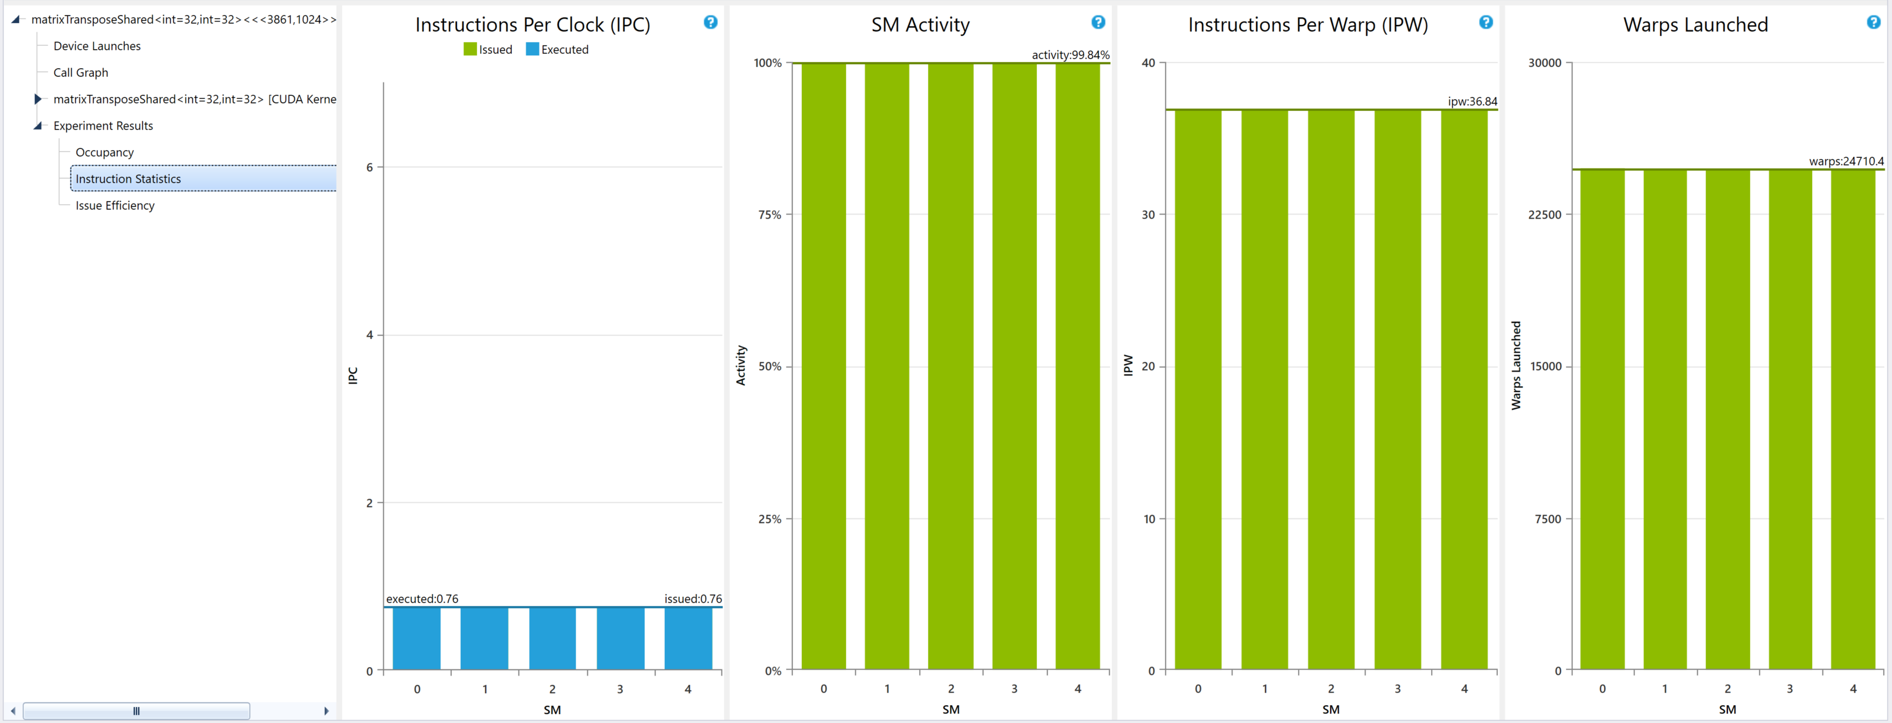
CUDA Launches – Instruction Statistics
Notes:
https://docs.nvidia.com/nsight-visual-studio-edition/5.6/Nsight_Visual_Studio_Edition_User_Guide.htm#Analysis/Report/CudaExperiments/KernelLevel/InstructionStatistics.htm%3FTocPath%3DAnalysis%2520Tools%7CCUDA%2520Experiments%7CKernel-Level%2520Experiments%7C_____4

Slide 27
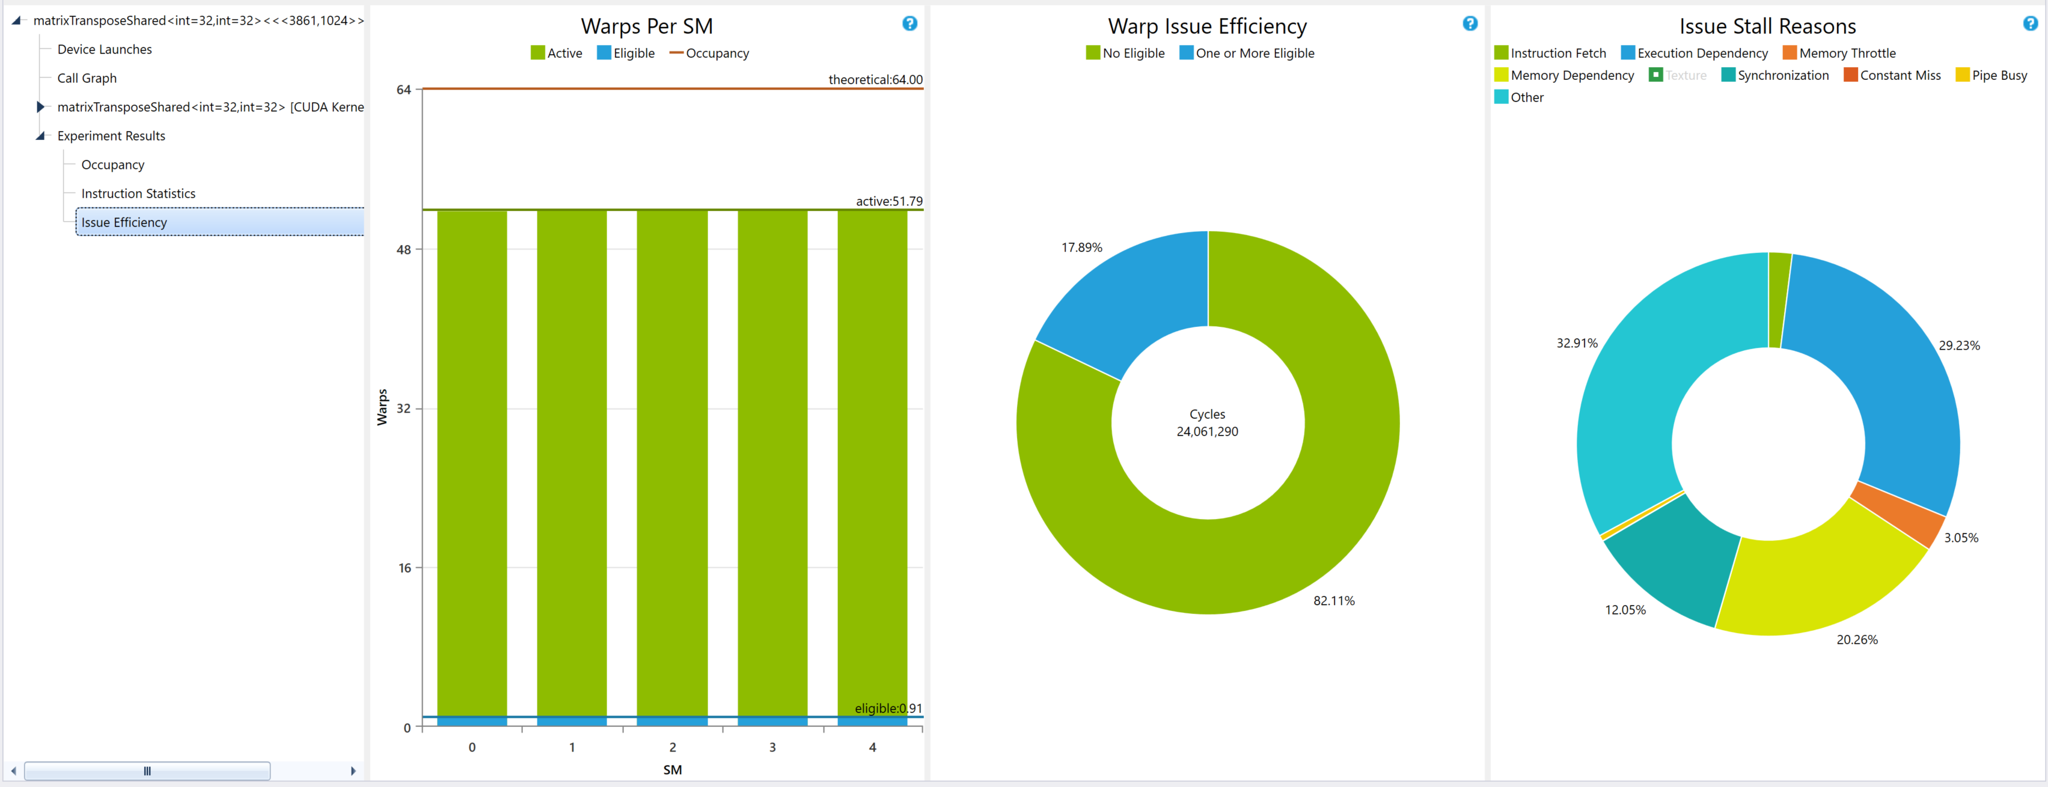
CUDA Launches – Issue Eficiency
Notes:
https://docs.nvidia.com/nsight-visual-studio-edition/5.6/Nsight_Visual_Studio_Edition_User_Guide.htm#Analysis/Report/CudaExperiments/KernelLevel/IssueEfficiency.htm%3FTocPath%3DAnalysis%2520Tools%7CCUDA%2520Experiments%7CKernel-Level%2520Experiments%7C_____5

Slide 28
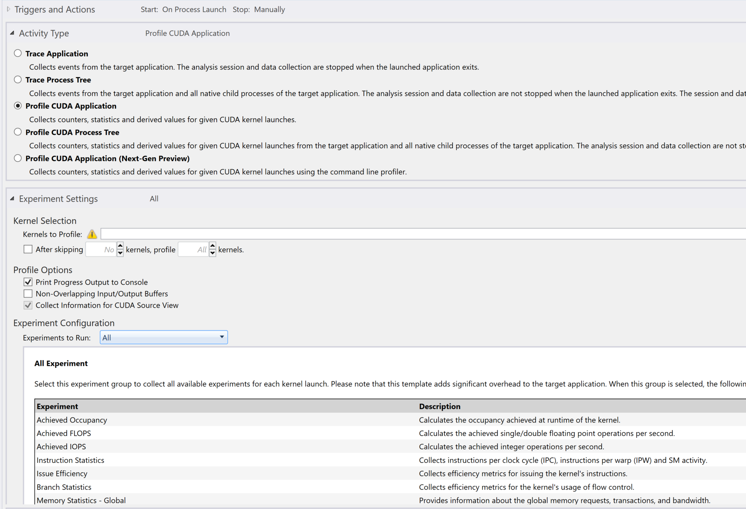
Let’s Profile CUDA Application
This time “All” Experiment

Slide 29
CUDA Launches
Occupancy, Instructions statistics, Issue Efficiency
Same as before
Now includes:
Branch Statistics
Achieved FLOPS / IOPS (Interger OPS)
Pipe Utilization
Memory Statistics
Along with “CUDA Source View”, include assembly/PTX instructions
Add –lineinfo flag for source code view

Slide 30
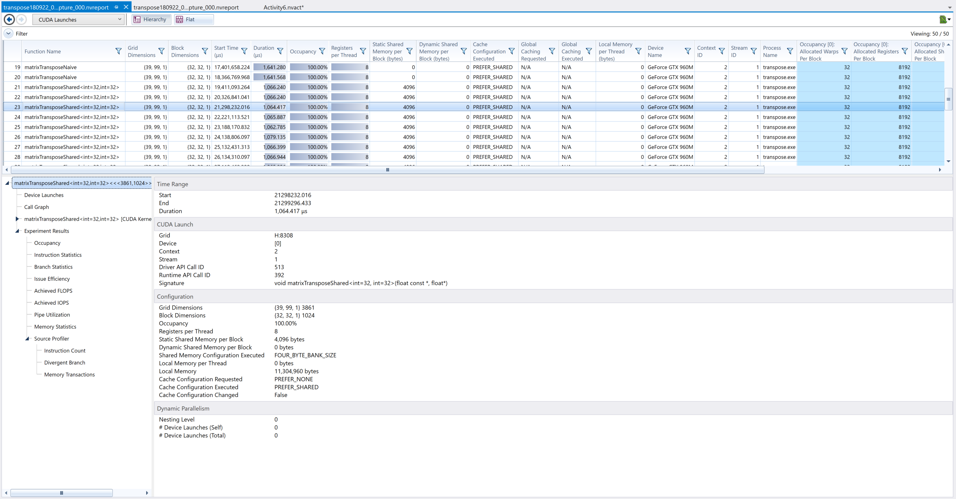
CUDA Launches

Slide 31
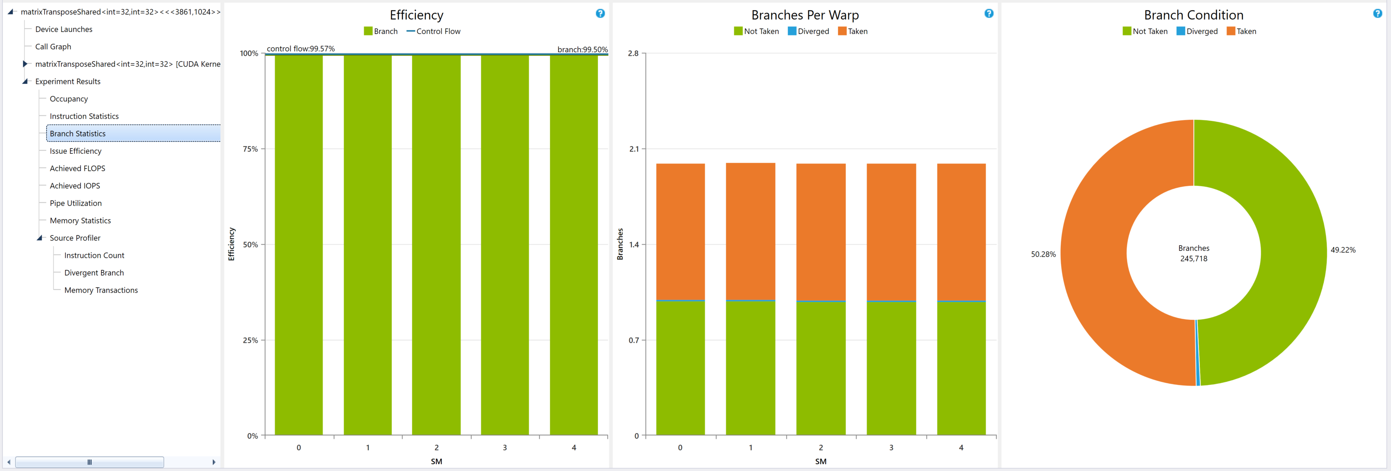
CUDA Launches – Branch Statistics
https://docs.nvidia.com/nsight-visual-studio-edition/5.6/Nsight_Visual_Studio_Edition_User_Guide.htm#Analysis/Report/CudaExperiments/KernelLevel/BranchStatistics.htm%3FTocPath%3DAnalysis%2520Tools%7CCUDA%2520Experiments%7CKernel-Level%2520Experiments%7C_____6

Slide 32
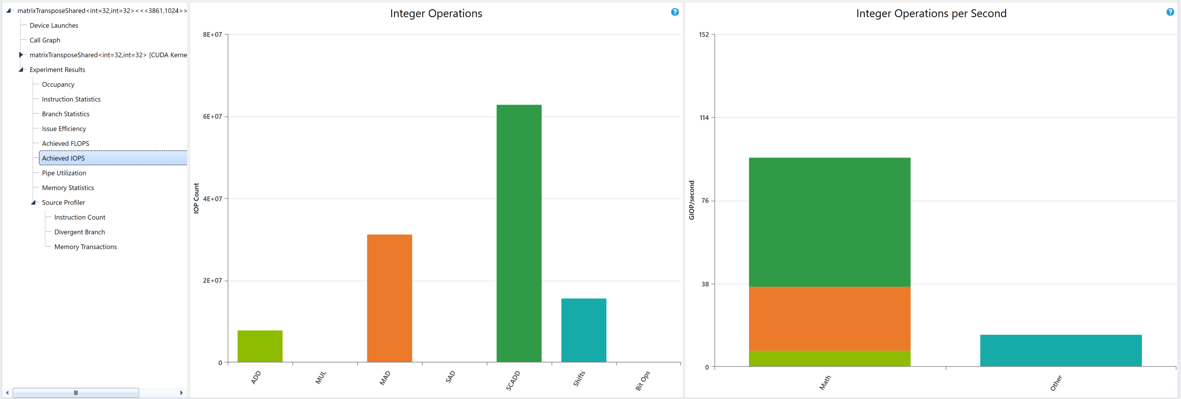
CUDA Launches – Achieved FLOPS/IOPS
https://docs.nvidia.com/nsight-visual-studio-edition/5.6/Nsight_Visual_Studio_Edition_User_Guide.htm#Analysis/Report/CudaExperiments/KernelLevel/AchievedFlops.htm%3FTocPath%3DAnalysis%2520Tools%7CCUDA%2520Experiments%7CKernel-Level%2520Experiments%7C_____2
https://docs.nvidia.com/nsight-visual-studio-edition/5.6/Nsight_Visual_Studio_Edition_User_Guide.htm#Analysis/Report/CudaExperiments/KernelLevel/AchievedIops.htm%3FTocPath%3DAnalysis%2520Tools%7CCUDA%2520Experiments%7CKernel-Level%2520Experiments%7C_____3

Slide 33
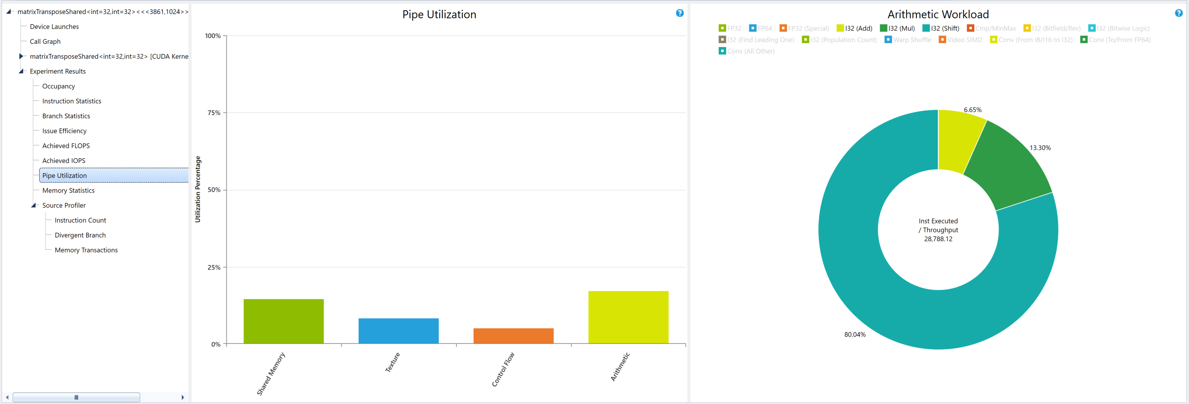
CUDA Launches – Pipe Utilization
https://docs.nvidia.com/nsight-visual-studio-edition/5.6/Nsight_Visual_Studio_Edition_User_Guide.htm#Analysis/Report/CudaExperiments/KernelLevel/PipeUtilization.htm%3FTocPath%3DAnalysis%2520Tools%7CCUDA%2520Experiments%7CKernel-Level%2520Experiments%7C_____8

Slide 34
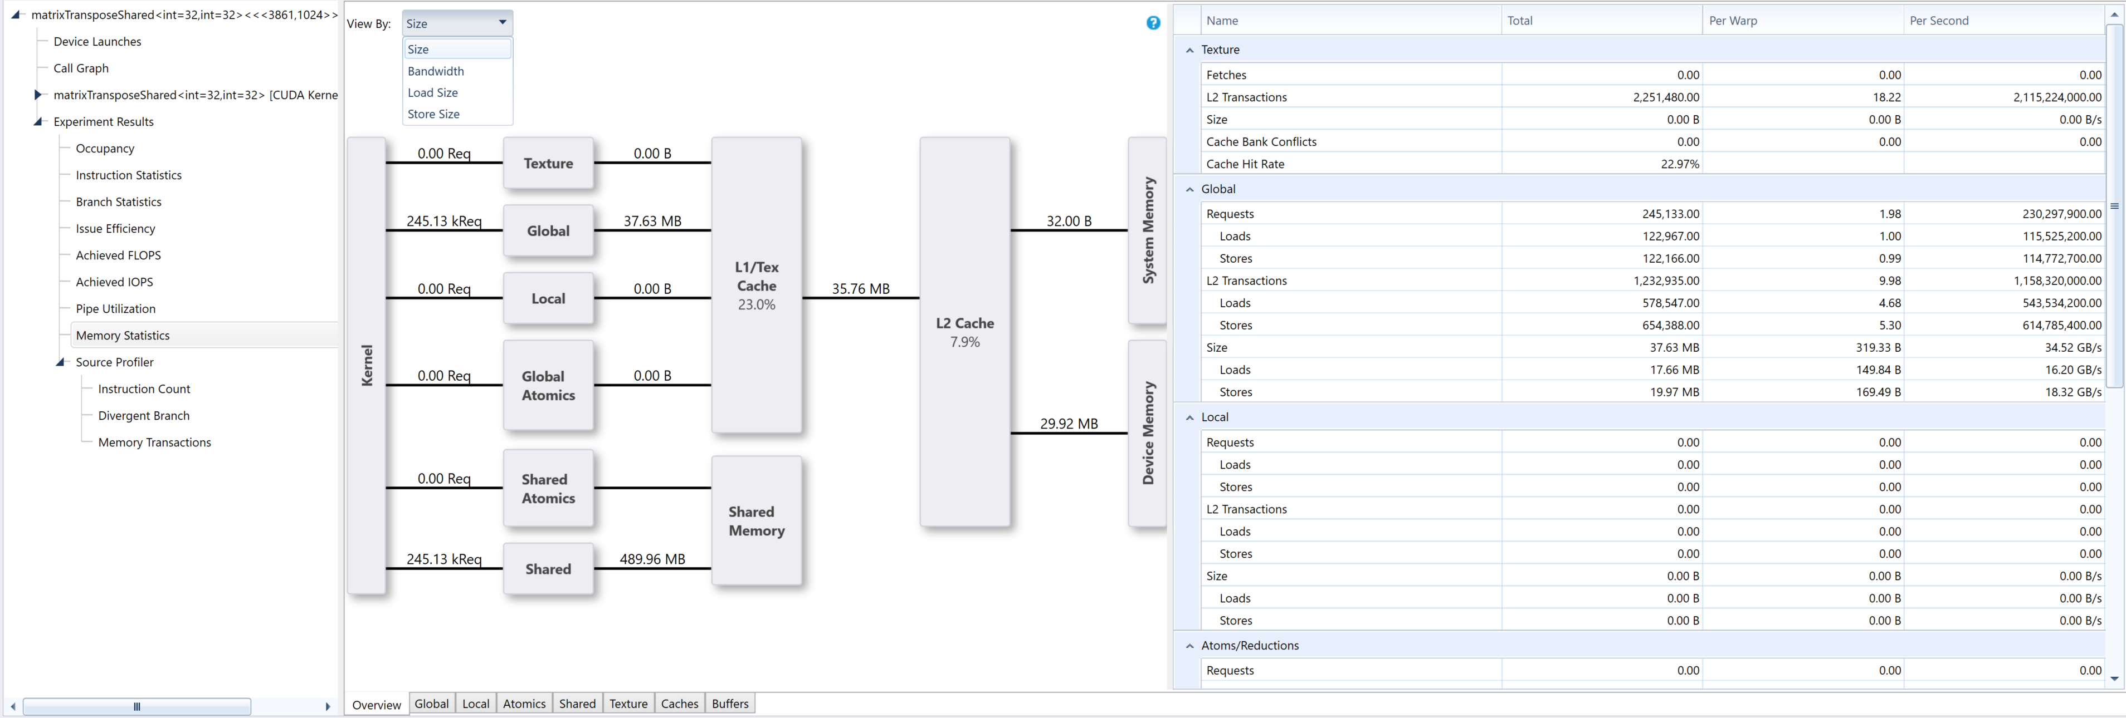
CUDA Launches – Memory Statistics
https://docs.nvidia.com/nsight-visual-studio-edition/5.6/Nsight_Visual_Studio_Edition_User_Guide.htm#Analysis/Report/CudaExperiments/KernelLevel/MemoryStatistics.htm%3FTocPath%3DAnalysis%2520Tools%7CCUDA%2520Experiments%7CKernel-Level%2520Experiments%7CMemory%2520Statistics%7C_____0

Slide 35
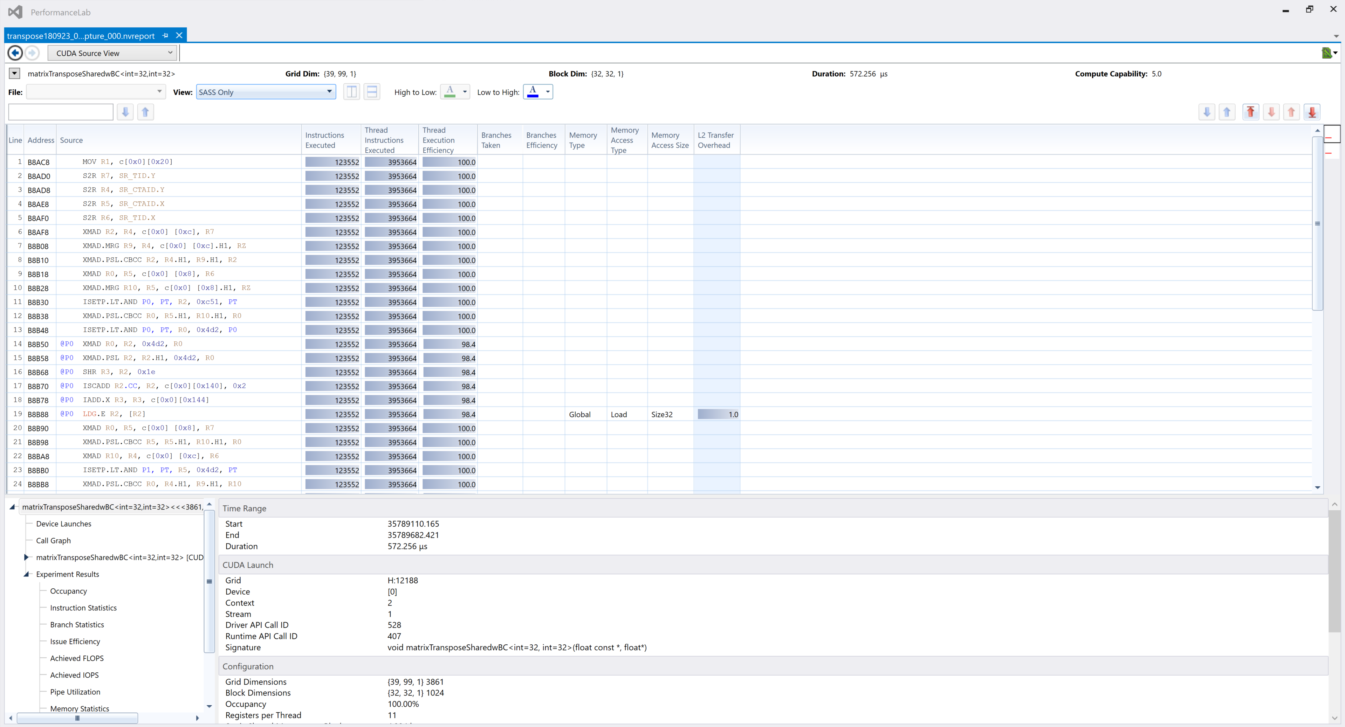
CUDA Source View

Slide 36
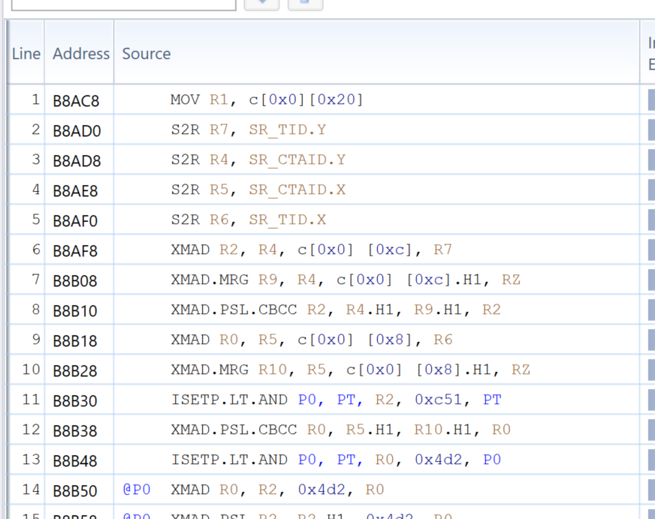
CUDA Source View

Slide 37

CUDA Source View

Slide 38
CUDA Source View
Release configuration does not include source code in .exe
Need to enable the -lineinfo compile option
Note: Also a security issue, anyone can reverse engineer your code
For pure Visual Studio Projects:
Project Properties page -> CUDA/C++ > Device.
For the field Generate Line Number Information, the default setting is No. Change to Yes (-lineinfo). Then click OK.
For CMake / Performance Lab, change line 39 of Cmakelists.txt
LIST(APPEND CUDA_NVCC_FLAGS ${CUDA_GENERATE_CODE}) to LIST(APPEND CUDA_NVCC_FLAGS ${CUDA_GENERATE_CODE} -lineinfo)
https://docs.nvidia.com/nsight-visual-studio-edition/5.6/Nsight_Visual_Studio_Edition_User_Guide.htm#Analysis_Source_Code_Correlation.htm?Highlight=lineinfo

Slide 39
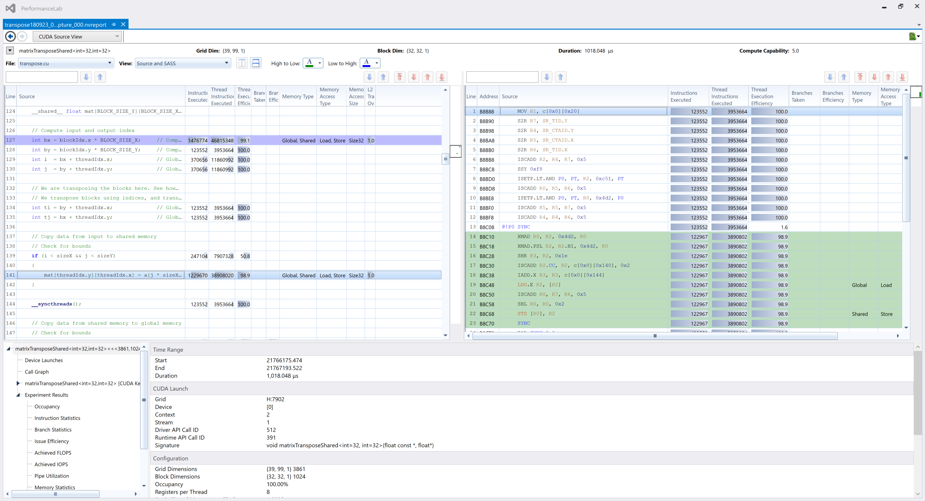
CUDA Source View
https://docs.nvidia.com/nsight-visual-studio-edition/5.6/Nsight_Visual_Studio_Edition_User_Guide.htm#Analysis/Report/CudaExperiments/Source_Level_Experiments.htm%3FTocPath%3DAnalysis%2520Tools%7CCUDA%2520Experiments%7CSource-Level%2520Experiments%7C_____0

Slide 40

CUDA Source View
https://docs.nvidia.com/nsight-visual-studio-edition/5.6/Nsight_Visual_Studio_Edition_User_Guide.htm#Analysis/Report/CudaExperiments/Source_Level_Experiments.htm%3FTocPath%3DAnalysis%2520Tools%7CCUDA%2520Experiments%7CSource-Level%2520Experiments%7C_____0

Slide 41
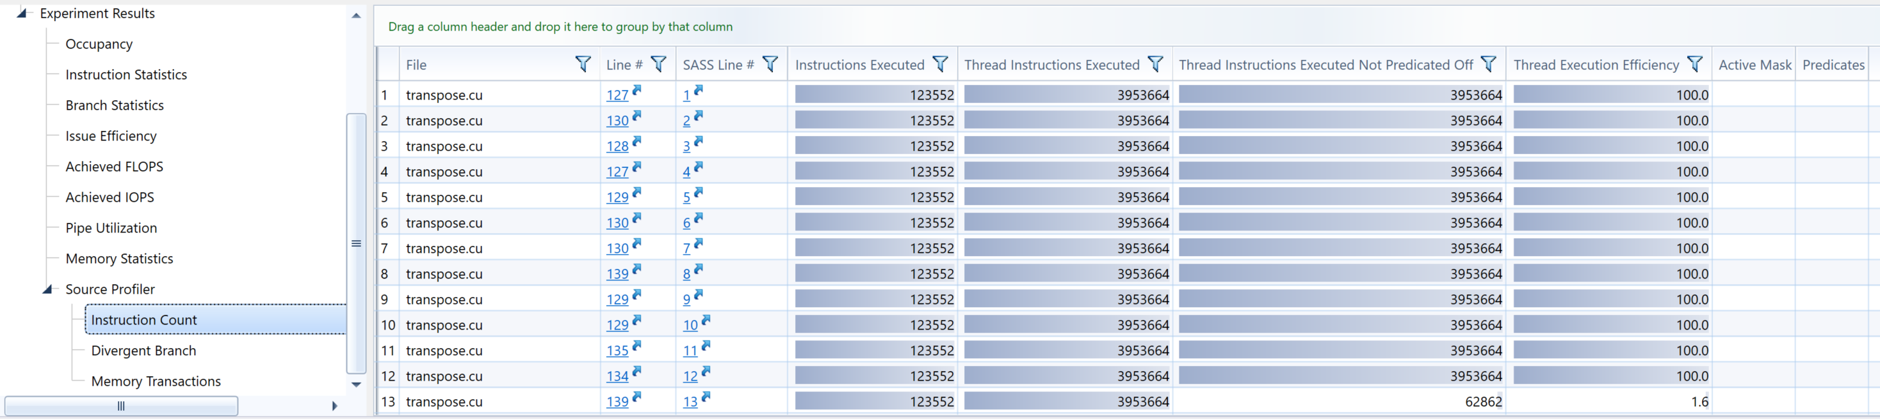
CUDA Source View - Instruction Count
Identifies instructions which do not execute for all threads in the warp
Hyperlinks to source code lines
https://docs.nvidia.com/nsight-visual-studio-edition/5.6/Nsight_Visual_Studio_Edition_User_Guide.htm#Analysis/Report/CudaExperiments/SourceLevel/InstructionCount.htm%3FTocPath%3DAnalysis%2520Tools%7CCUDA%2520Experiments%7CSource-Level%2520Experiments%7C_____2

Slide 42
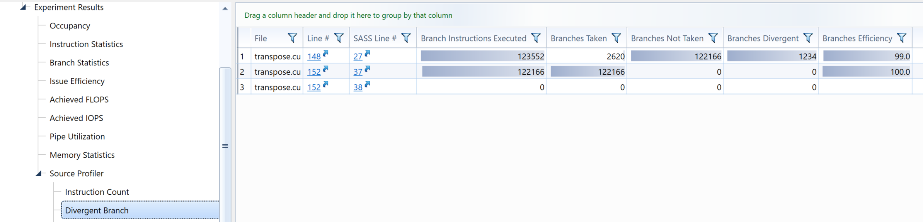
CUDA Source View – Divergent Branch
Finds branch-able instructions then count how many times each branch:
was taken by any threads in the warp
not taken by any threads in the warp
diverged (some threads branched and some did not).
Hyperlinks to source code of branchable code
https://docs.nvidia.com/nsight-visual-studio-edition/5.6/Nsight_Visual_Studio_Edition_User_Guide.htm#Analysis/Report/CudaExperiments/SourceLevel/DivergentBranch.htm%3FTocPath%3DAnalysis%2520Tools%7CCUDA%2520Experiments%7CSource-Level%2520Experiments%7C_____1

Slide 43
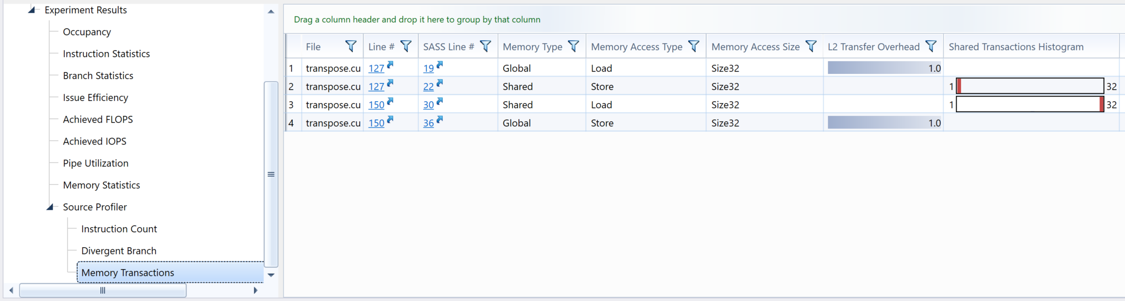
CUDA Source View – Memory Tranx
Detailed statistics for memory transactions
Distribution of executed L1 memory transactions per instruction executed. Bins with a non-zero count have gray bars, and the highest bin has a red bar. A good histogram has only counts in the lower bins.
Hyperlinks to source code of branchable code
https://docs.nvidia.com/nsight-visual-studio-edition/5.6/Nsight_Visual_Studio_Edition_User_Guide.htm#Analysis/Report/CudaExperiments/SourceLevel/MemoryTransactions.htm%3FTocPath%3DAnalysis%2520Tools%7CCUDA%2520Experiments%7CSource-Level%2520Experiments%7C_____3

Slide 44
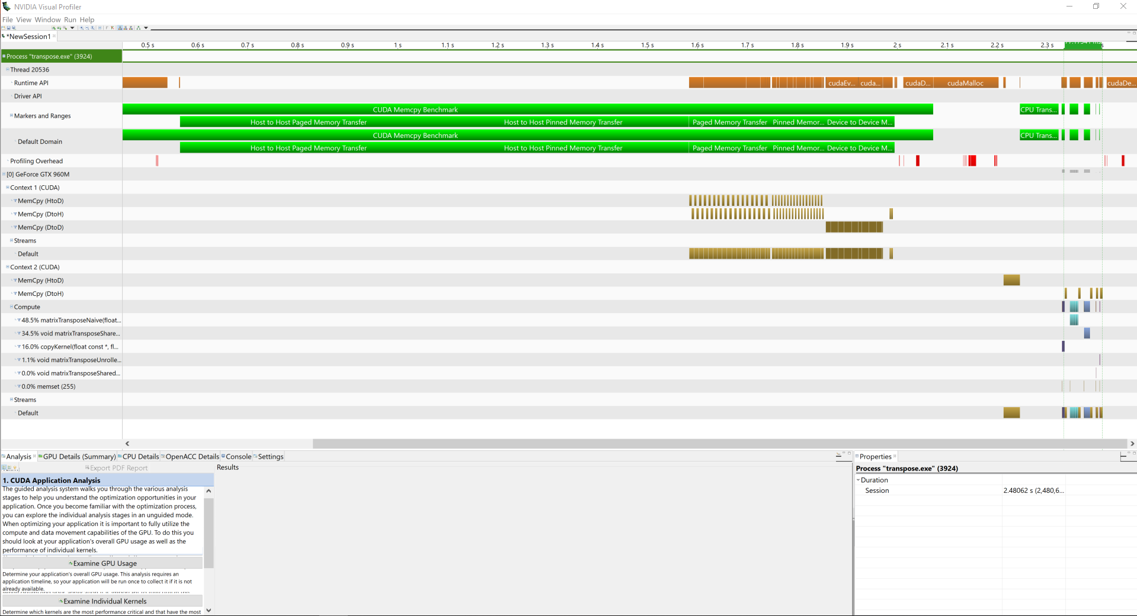
Visual Profiler
https://docs.nvidia.com/cuda/archive/9.2/profiler-users-guide/index.html#visual

Slide 45
Visual Profiler
Allows you to visualize and optimize the performance of your application.
Primary tool is the timeline.
Detect potential performance bottlenecks.
Also suggests how to take action to eliminate or reduce those bottlenecks.
Standalone application and available on Linux.

Slide 46
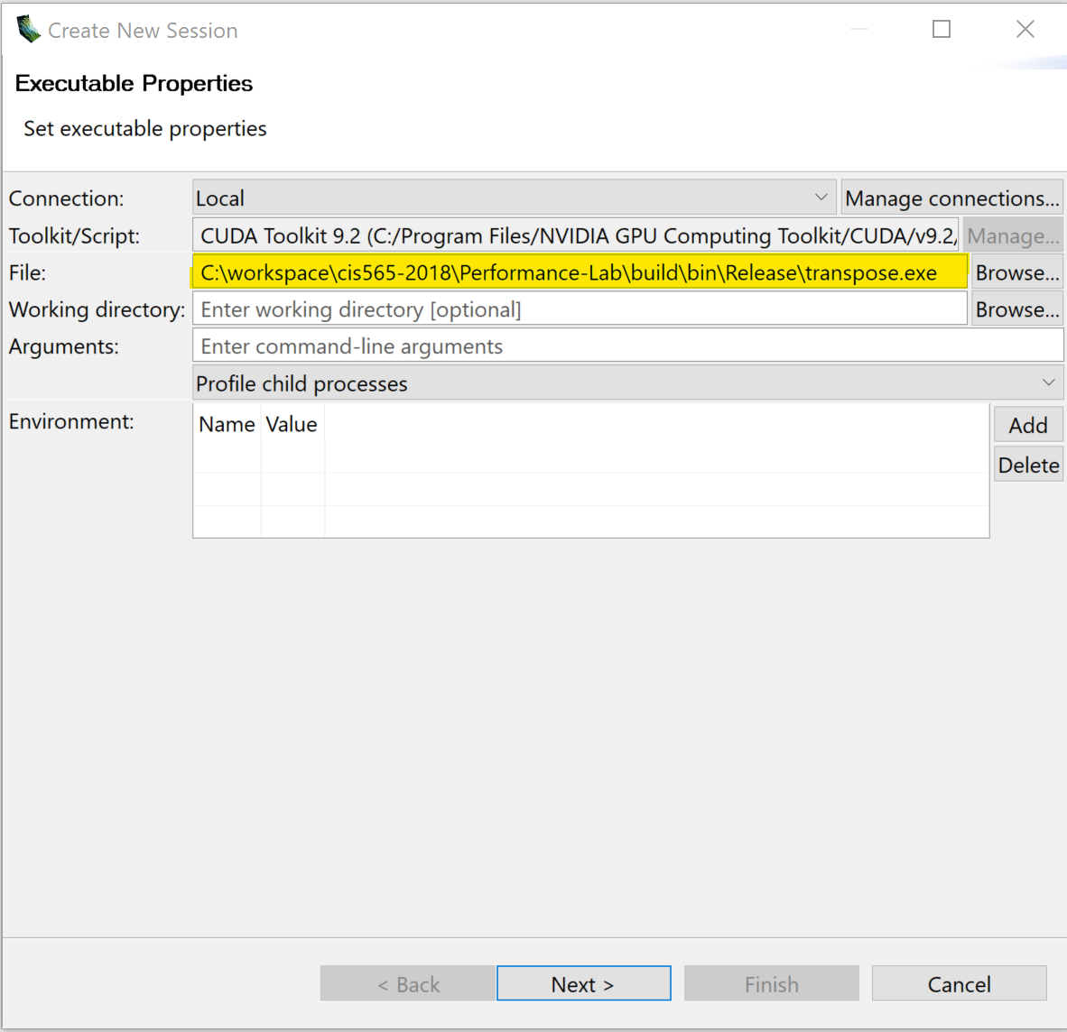
Starting the Profiler
Specify executable
Also allows specifying
Working directory
CLI arguments
Custom environment variables
Click Next, use the default options
Click finish

Slide 47
Timeline

Slide 48
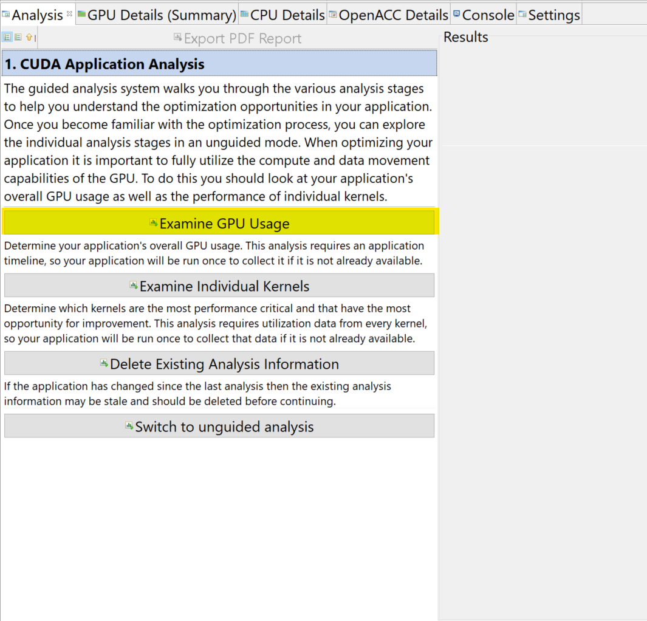
Guided Analysis
Profiler examines the application and gives suggestions on what can be improved
https://docs.nvidia.com/cuda/archive/9.2/profiler-users-guide/index.html#analysis-view

Slide 49
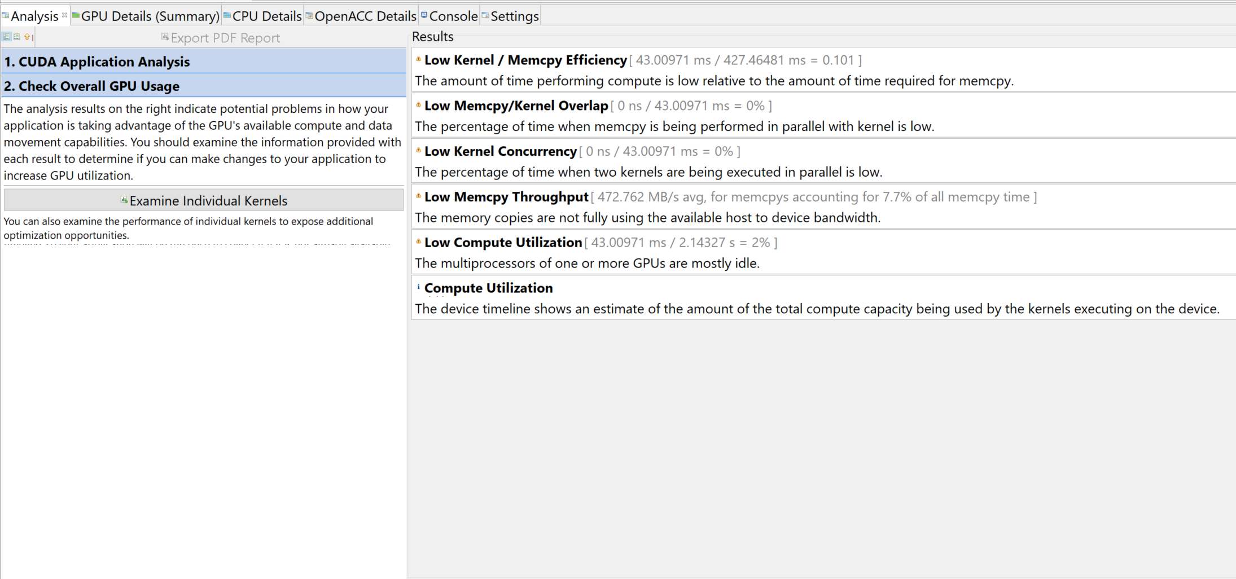
Examine GPU Usage - Results

Slide 50
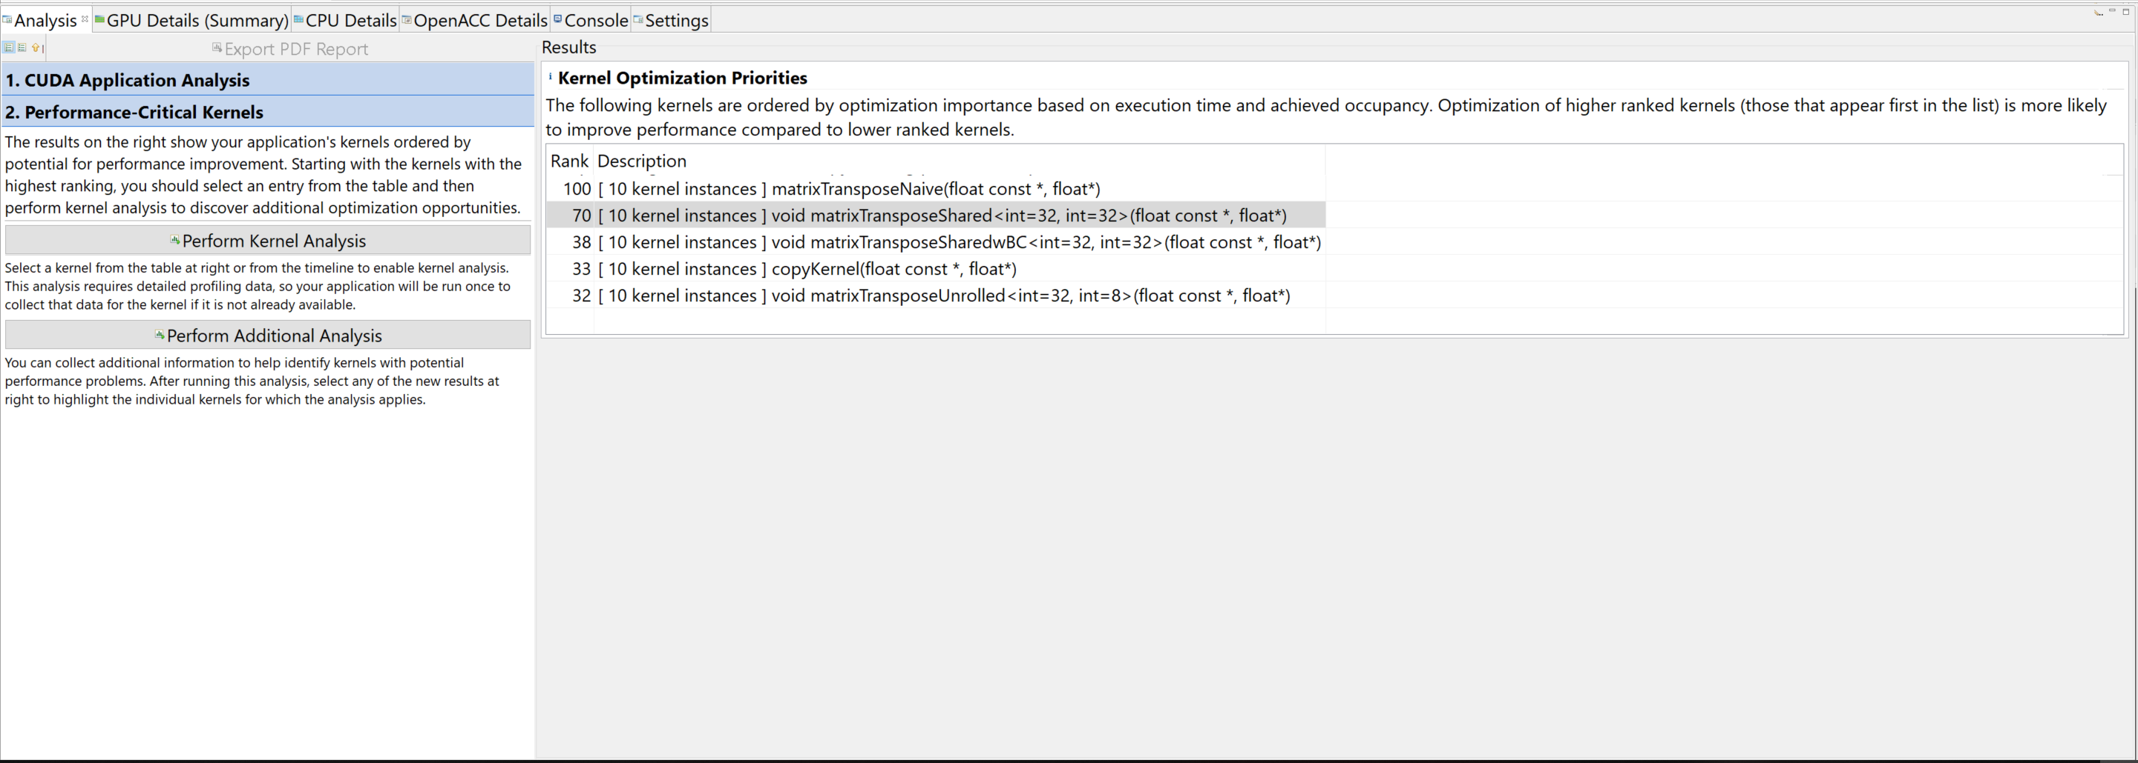
Guided Analysis
After GPU Usage, individual kernel can be analyzed.
Kernels with higher rank score (higher in the list)
can be more optimized

Slide 51
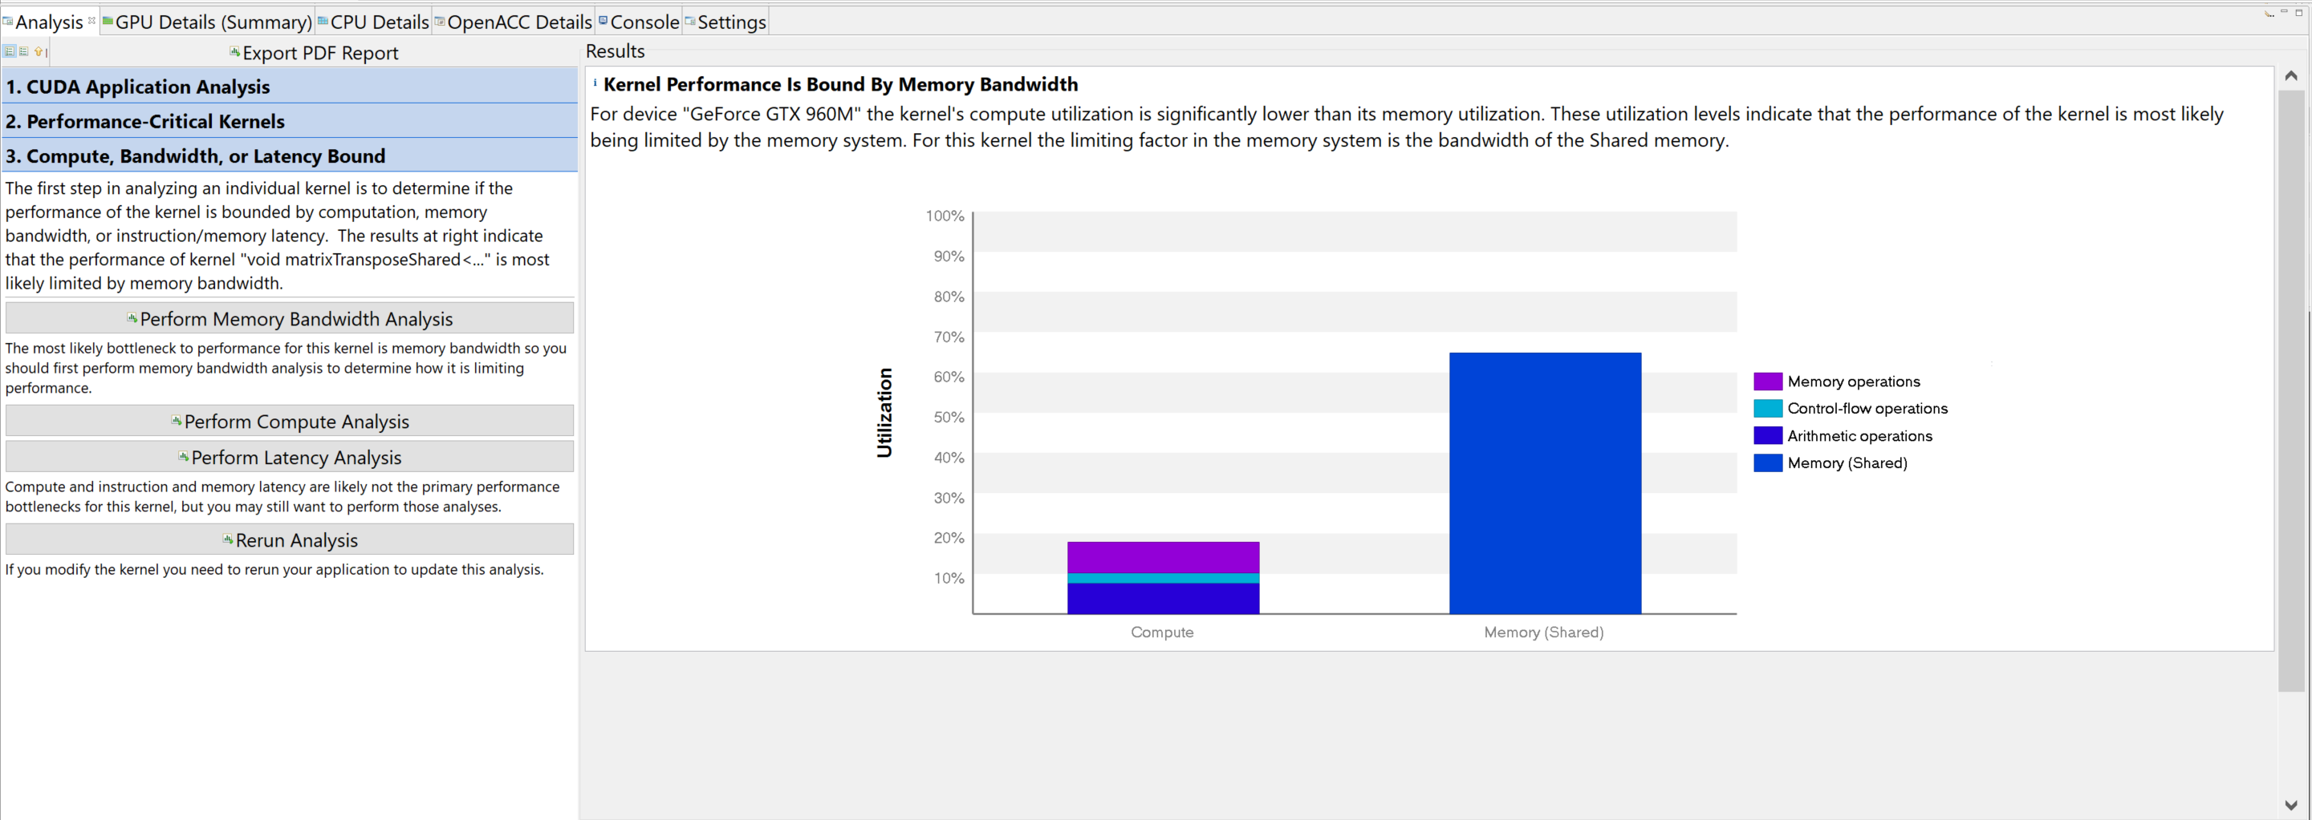
Perform Kernel Analysis - Results
Each analysis produces compute and other information
Can run additional, more specific analysis

Slide 52
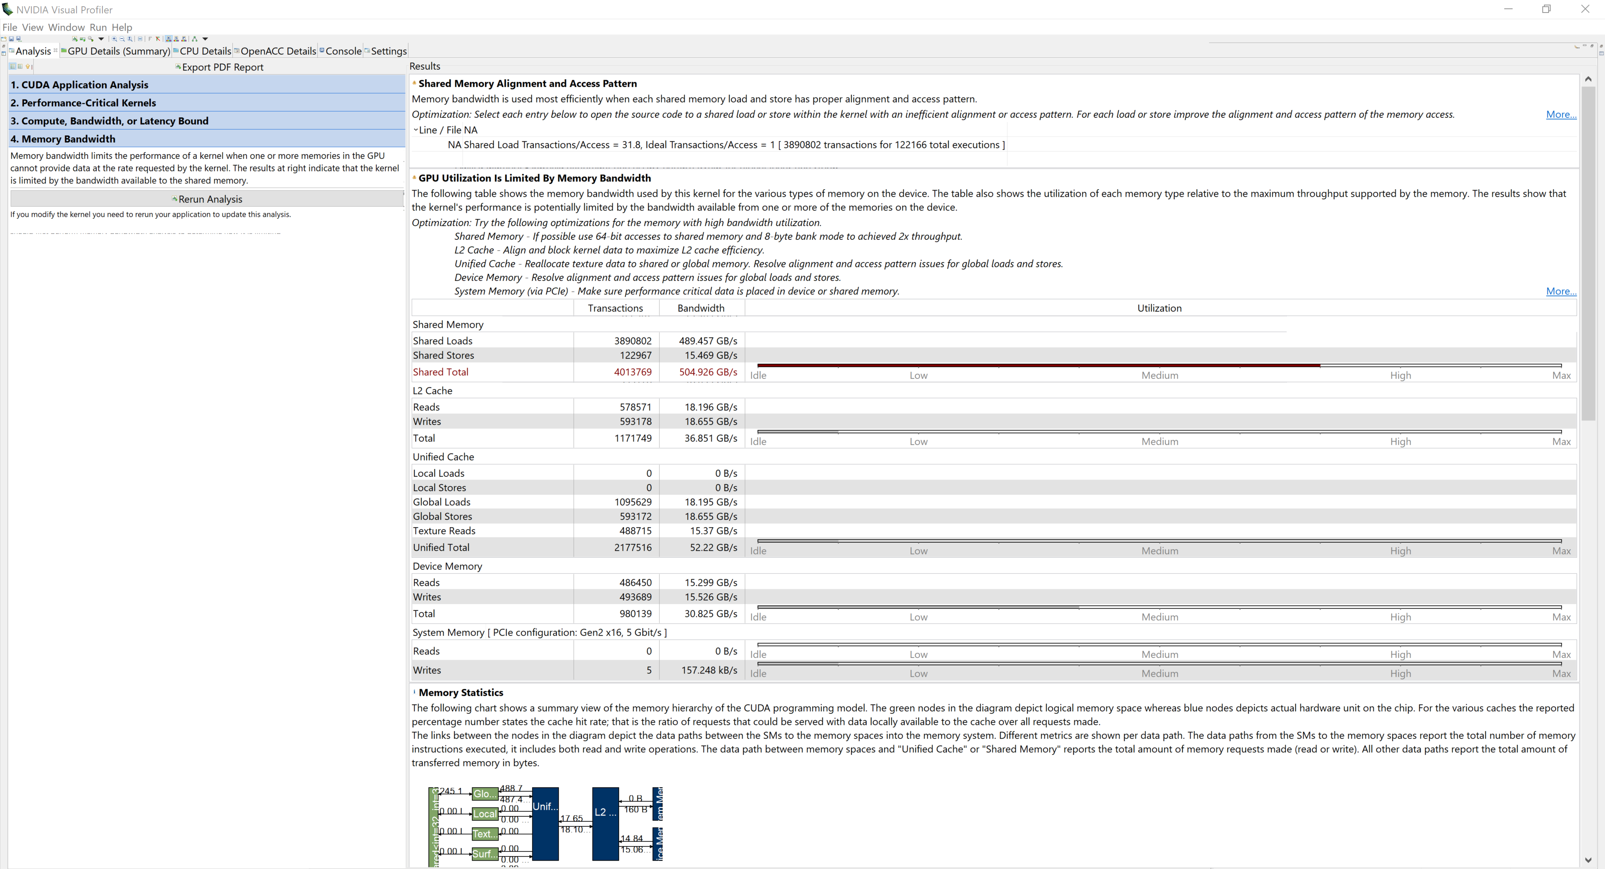
Memory Bandwidth Analysis - Results

Slide 53
Memory Bandwidth Analysis - Results

Slide 54
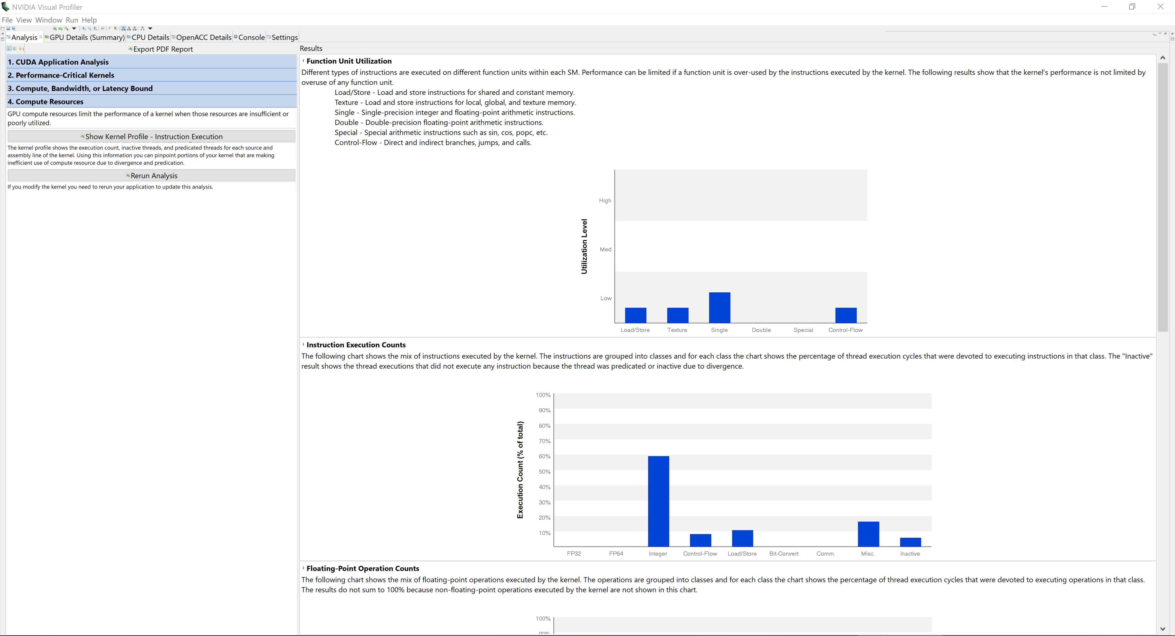
Compute Analysis Results

Slide 55
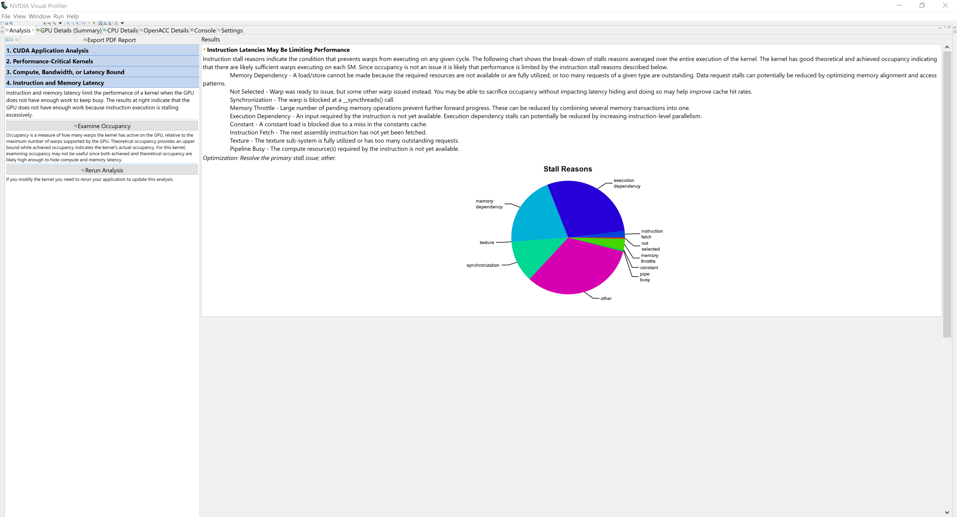
Latency Analysis - Results

Slide 56
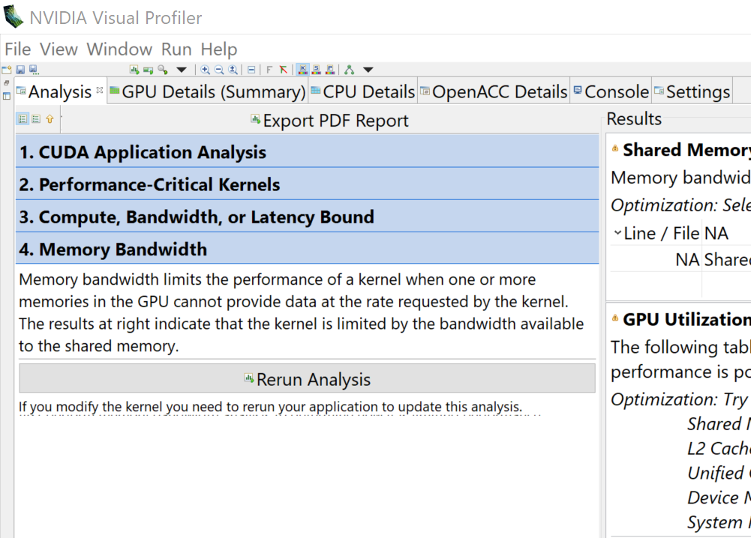
Go back and rerun other analysis
Click on any tab to go back and run other analysis

Slide 57
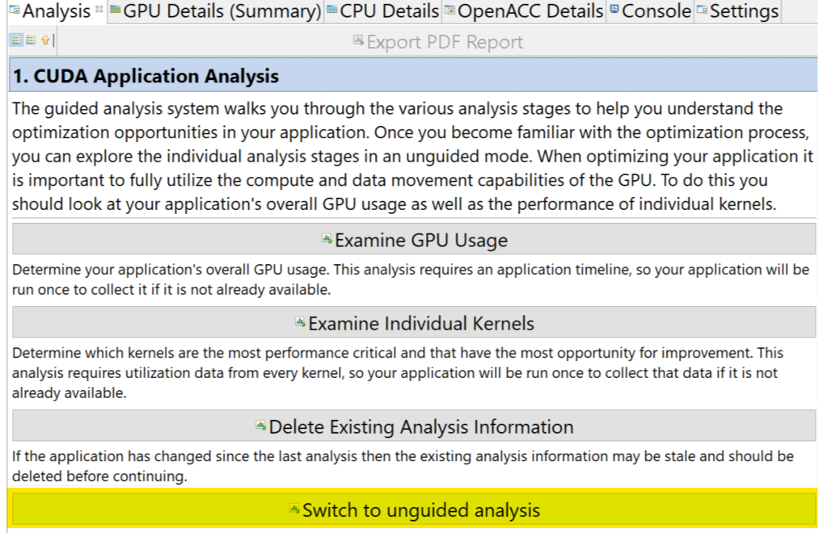
Unguided Analysis
Gives more low-level information that a developer can review

Slide 58
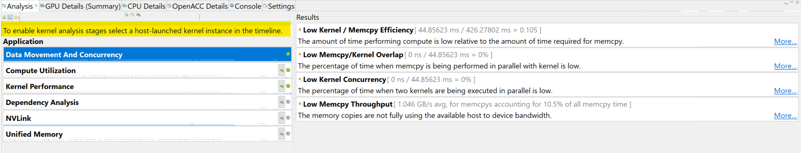
Unguided Analysis
Click a kernel on the timeline to see more information

Slide 59

Unguided Analysis - Kernels
May need to click “Run Analysis”

Slide 60

Unguided Analysis - Kernels

Slide 61


Unquided Analysis - Kernels
Offending instruction
LDS.U.32 R0 [R0]
Assembly instructions!!!

Slide 62

After adding -lineinfo

Slide 63
Next-Gen Tools Nsight and Nsight Compute
Pascal

Slide 64
Next-Gen Profiling Tools
Nsight Compute is a standalone tool by itself
Nsight for Visual Studio + Nsight Compute
Nsight can run Nsight Compute in the background
Nsight for Visual Studio Documentation: http://docs.nvidia.com/nsight-visual-studio-edition/Nsight_Visual_Studio_Edition_User_Guide.htm
Nsight Compute Documentation: https://docs.nvidia.com/nsight-compute/NsightCompute/index.html

Slide 65
Running Nsight Profiler
Nsight -> Start Performance Analysis

Slide 66

https://docs.nvidia.com/nsight-visual-studio-edition/Nsight_Visual_Studio_Edition_User_Guide.htm#Activity_Document.htm

Slide 67

https://docs.nvidia.com/nsight-visual-studio-edition/Nsight_Visual_Studio_Edition_User_Guide.htm#Activity_Document.htm

Slide 68

https://docs.nvidia.com/nsight-visual-studio-edition/Nsight_Visual_Studio_Edition_User_Guide.htm#Activity_Document.htm

Slide 69

https://docs.nvidia.com/nsight-visual-studio-edition/Nsight_Visual_Studio_Edition_User_Guide.htm#Analysis_Compute_Profiler.htm

Slide 70



https://docs.nvidia.com/nsight-visual-studio-edition/Nsight_Visual_Studio_Edition_User_Guide.htm#Analysis_Compute_Profiler.htm

Slide 71

Session Page
https://docs.nvidia.com/nsight-compute/NsightCompute/index.html#profiler-report-session-page

Slide 72

Summary Page
https://docs.nvidia.com/nsight-compute/NsightCompute/index.html#profiler-report-summary-page

Slide 73

Raw Page
https://docs.nvidia.com/nsight-compute/NsightCompute/index.html#profiler-report-raw-page

Slide 74
Details Page
Sections Doc: https://docs.nvidia.com/nsight-compute/NsightCompute/index.html#sections-and-rules
https://docs.nvidia.com/nsight-visual-studio-edition/Nsight_Visual_Studio_Edition_User_Guide.htm#Analysis_Compute_Profiler.htm

Slide 75

Compute Workload Analysis
https://docs.nvidia.com/nsight-visual-studio-edition/Nsight_Visual_Studio_Edition_User_Guide.htm#Analysis_Compute_Profiler.htm

Slide 76

Memory Workload Analysis
https://docs.nvidia.com/nsight-visual-studio-edition/Nsight_Visual_Studio_Edition_User_Guide.htm#Analysis_Compute_Profiler.htm

Slide 77

Scheduler Statistics
https://docs.nvidia.com/nsight-visual-studio-edition/Nsight_Visual_Studio_Edition_User_Guide.htm#Analysis_Compute_Profiler.htm

Slide 78

Warp State Statistics
https://docs.nvidia.com/nsight-visual-studio-edition/Nsight_Visual_Studio_Edition_User_Guide.htm#Analysis_Compute_Profiler.htm

Slide 79

Instruction Statistics
CUDA Instruction Sets per Architecture: https://docs.nvidia.com/cuda/cuda-binary-utilities/index.html#instruction-set-ref
https://docs.nvidia.com/nsight-visual-studio-edition/Nsight_Visual_Studio_Edition_User_Guide.htm#Analysis_Compute_Profiler.htm

Slide 80

Launch Statistics
https://docs.nvidia.com/nsight-visual-studio-edition/Nsight_Visual_Studio_Edition_User_Guide.htm#Analysis_Compute_Profiler.htm

Slide 81

Occupancy Statistics
https://docs.nvidia.com/nsight-visual-studio-edition/Nsight_Visual_Studio_Edition_User_Guide.htm#Analysis_Compute_Profiler.htm

Slide 82

Baselines
https://docs.nvidia.com/nsight-compute/NsightCompute/index.html#baselines

Slide 83

Source Page
Source Page
https://docs.nvidia.com/nsight-compute/NsightCompute/index.html#profiler-report-source-page

